Slide 1
Successful Pathways to Professional Helping
Renee coletrain, MSW, HS-BCP
becOPRODUCTIONS@GMAIL.COM

Slide 2
OBJECTIVES
UNDERSTAND THE IMPORTANCE OF NETWORKING
IDENTIFY EMPLOYMENT SOFT SKILLS
IDENTIFY CAREER OPTIONS FOR MASTERS LEVEL PROFESSIONALS
ACCESS RESOURCES THAT LEAD TO EMPLOYMENT

Slide 3
Understanding the Importance of Networking
Step 1 Building Bridges
Obtain new relationships
Attend different meetings in the community
Step 2 Engagement
Join your professional organization
Step 3 Solidify Partnerships
Follow Up with Your new contacts
Attend conferences, workshops, & training
Call new contacts and request for them to join you in professional activities

Slide 4
Effective Networking Can Lead To:
Lasting Partnerships
Recognition/ Exposure
Opportunities/ Employment

Slide 5
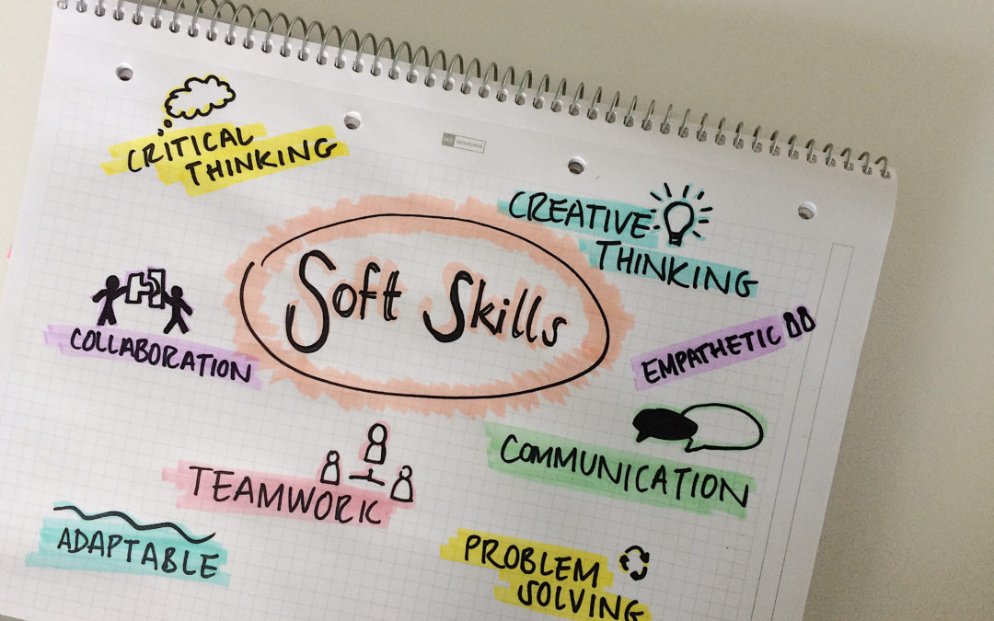

Identify Soft Skills That Are Important for Maintaining Employment

Slide 6

The Interviewing Process

Slide 7


Dressing for an Interview What is OK!

Slide 8

How to Dress
ü
Suit
Tie
White shirt
Grooming

Slide 9


Dressing for an Interview Inappropriate attire!

Slide 10

Inappropriate Attire
Loud colors
Stained clothing
Tight/Sexy clinging clothing
Bold jewelry
Too much cologne/perfume
Poor grooming

Slide 11

Develop a Solid Action Plan for Maximizing you Networking Skills
Volunteer to serve on a Board
Attend community meetings
Speak with supervisor about representing your department
Attend community council meeting

Slide 12

Develop Plans for Building Access to Human Services / Social Work Resources.
Collect business cards
Attend professional conferences
Join Professional organizations
LinkedIn

Slide 13
Resources
WWW.MONSTER.COM
HTTPS://JOBS.TOGETHERSC.ORG/JOBS/
WWW.SOCIALWORKERS.ORG
WWW.NATIONALHUMANSERVICES.ORG
https://amhca.nationalhealthcarecareers.com
WWW.DAODAS.SC.GOV
HTTPS://WWW.SAMHSA.GOV

Slide 14

QUESTIONS ???

