Slide 1
Suicide in Various Populations: Clinical Overview
Mark L De Santis, MS, Psy.D.
Suicide Prevention Coordinator
Ralph H Johnson VAMC
Assistant Professor
Dept. of Psychiatry and Behavioral Sciences
Medical University of South Carolina
Cross Cultural Conference
February 24, 2019

Slide 2
Suicide Prevention
Outline
Mental Illness
Mental illness and Violence risk
Limbic System Response
Risk Factors
Symptoms
Psychosocial Factors and Stressors
Protective Factors
Assessment Guide
Treatment
Safety Planning
Questions

Slide 3
Mental Illness
Mental Illness - any of various disorders in which a person's thoughts, emotions, or behavior are so abnormal as to cause suffering to himself, herself, or other people.
The third component is …time.

Slide 4
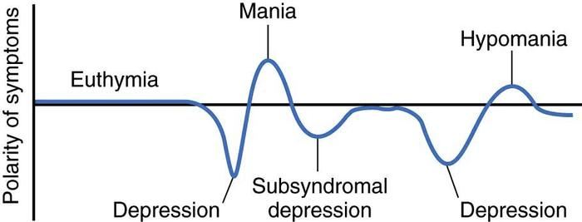
Mood Disorders

Slide 5
Severe Mental Illness
Are people with severe mental illness more likely to perpetrate violence or be the recipient of violence?

Slide 6
Severe Mental Illness and Violence risk Teplin, et. Al., 2005)
  Of 936 receiving services, >25% had been victims of a violent crime (attempted or completed) in the past year…11 times higher than the general population.
  17% had been victims of completed violence.
  21% had been victims of personal theft; general population 0.2%...140 times higher.
  28% had been victims of property crime; general population 8.4%.

Slide 7
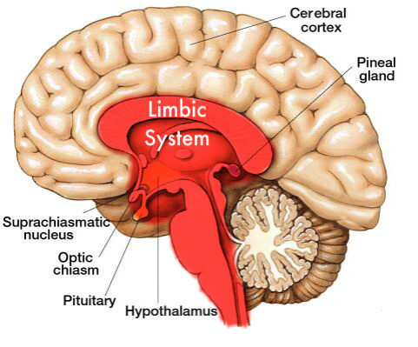
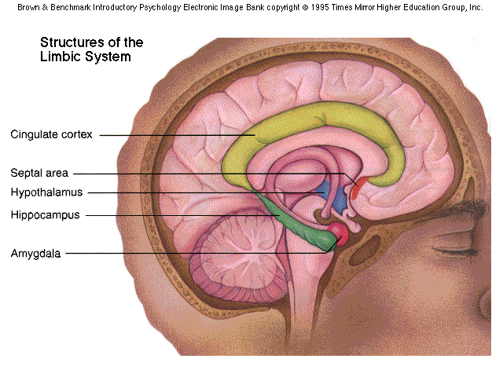
Physiology & Limbic System

Slide 8
Worldwide Data
Over 1,000,000 people die by suicide every year.
There is one death by suicide in the world every 40 seconds.
Suicide is the second leading cause of death among 15–29 year-olds
Suicide is the 3rd leading cause of death in the world for those aged 15-44 years.
(WHO 2016)
Notes:
Ever since the 1920’s data on suicides has been on the rise. These are garnered from coroners reports.

Slide 9
Suicide Rates By Country
1 | Guyana | 44.2
2 | South Korea | 28.9
3 | Sri Lanka | 28.8
4 | Lithuania | 28.2
5 | Suriname | 27.8
6 | Mozambique | 27.4
7 | Tanzania | 24.9
8 | Nepal | 24.9
9 | Kazakhstan | 23.8
10 | Burundi | 23.1
43 | USA | 17.9
Notes:
Before showing this, ask them where they think the US ranks worldwide. Some studies late that we are 38th. Keep this in mind when you see US data and it wills still shock you.

Slide 10
Suicide Prevention
Brief overview
Suicide in the U.S.
13.5 % of all Americans report a history of suicidal ideation or thinking
3.9 % actually made a suicide plan that included a definite time, place and method
4.6 % reported actual suicide attempts
50 % of those who attempted suicide reported having made a “serious” attempt
Notes:
13.5% equals roughly about 40 million people. Show that you cannot predict suicide , more people reported suicide attempts than had a plan. Speak to impulsive behaviors and limbic system again.

Slide 11
Suicide Prevention
Brief Overview
Suicide in the U.S. (2012 CDC and SAMSHA data)
Suicide is the Tenth leading cause of death for all ages:
Every 12 minutes another life is lost to suicide.
Every 30 seconds there is an attempt
Almost four times as many males as females die by suicide.
Older Americans (males) and 45 to 55 (males & females) are disproportionately likely to die by suicide
White males 85+ are 4 times higher the nation’s overall rate
Notes:
Rates have kept going up in the general population since the 1920’s ever since data has been collected from Coroner’s reports

Slide 12
Suicide Statistics
Suicide in the U.S. (2014)
Homicide in the U.S. (16,121) Suicide (42,773) = More than twice the number.
There are now twice as many deaths due to suicide than due to HIV/AIDS.
In the month prior to their suicide, 75% of elderly
persons had visited a physician.

Slide 13
Breakdown by Gender / Ethnicity / Young, Old Age Groups
All Ages Combined |  |  | Elderly (65+ yrs) |  | Youth (15-24 yrs)
Group | Number of Suicides | Rate of Suicide | Elderly Suicides | Elderly Suicide Rate | Youth Suicides | Youth Suicide Rate
Nation | 32,637 | 11.0 | 5,404 | 14.7 | 4,212 | 10.0
Men | 25,907 | 17.7 | 4,550 | 29.5 | 3,498 | 16.2
Women | 6,730 | 4.5 | 854 | 4.0 | 714 | 3.5
Whites | 29,527 | 12.3 | 5,410 | 15.9 | 3,540 | 10.7
Nonwhites | 3,110 | 5.5 | 264 | 5.8 | 672 | 7.4
Blacks | 1,992 | 5.1 | 152 | 4.8 | 437 | 6.7
White Men | 23,478 | 19.7 | 4,361 | 32.1 | 2,945 | 17.3
White Women | 6,049 | 5.0 | 779 | 4.2 | 595 | 3.7
Nonwhite Men | 2,429 | 9.0 | 189 | 10.5 | 553 | 12.0
Nonwhite Women | 681 | 2.3 | 75 | 2.7 | 119 | 2.7
African Amer Men | 1,621 | 8.7 | 124 | 10.3 | 382 | 11.5
African Amer Women | 371 | 1.8 | 28 | 1.4 | 55 | 1.7
AAS, CDC (08/2008)
Notes:
AS you will see the data has continued to rise across the board regardless of age, gender or race. What stands out the most is that the data for males is always the highest in each category, regardless of race or age when compared to their female counterparts.

Slide 14
Breakdown by Gender / Ethnicity / Young, Old Age Groups
All Ages Combined |  |  | Elderly (65+ yrs) |  | Youth (15-24 yrs)
Group | Number of Suicides | Rate of Suicide | Elderly Suicides | Elderly Suicide Rate | Youth Suicides | Youth Suicide Rate
Nation | 38,364 | 12.4 | 5,994 | 14.9 | 4,600 | 10.5
Men | 30,277 | 20.0 | 4,550 | 29.5 | 3,498 | 16.2
Women | 8,087 | 5.2 | 854 | 4.0 | 714 | 3.5
Whites | 34,690 | 14.1 | 5,410 | 15.9 | 3,540 | 10.7
Nonwhites | 3,674 | 5.8 | 264 | 5.8 | 672 | 7.4
African Amer | 2,144 | 5.1 | 152 | 4.8 | 437 | 6.7
White Men | 27,422 | 22.6 | 4,361 | 32.1 | 2,945 | 17.3
White Women | 7,268 | 5.9 | 779 | 4.2 | 595 | 3.7
Nonwhite Men | 2855 | 9.4 | 189 | 10.5 | 553 | 12.0
Nonwhite Women | 819 | 2.5 | 75 | 2.7 | 119 | 2.7
African Amer Men | 1621 | 8.7 | 124 | 10.3 | 382 | 11.5
African Amer Women | 371 | 1.8 | 28 | 1.4 | 55 | 1.7
CDC, AAS (11/2010)
Notes:
For this slide and the next slides on rates, please focus on the overall number and that rates have been increasing since the 1920’s when initiation data was begun.

Slide 15
USA Suicide 2014 Data
Number Per Day. Rate % of Deaths
Nation ..................................... 42,773 ........... 117.2 ............ 13.4 ............. 1.6
Males ...................................... 33,113 ............. 90.7 ............ 21.1 ............. 2.5
Females .................................... 9,660 .............. 26.5 .............. 6.0 ............. 0.7
Whites .................................... 38,675 ............ 106.0 ............ 15.4 ............. 1.7
Nonwhites ................................. 4,098 .............. 11.2 .............. 6.0 ............. 1.1
Blacks ....................................... 2,421 ................ 6.6 .............. 5.5 ............. 0.8
Elderly (65+ yrs.) ...................... 7,693 .......... .... 21.1 ............ 16.6 ............ 0.4
Young (15-24 yrs.) .................... 5,079 .............. 13.9 ............ 11.6 ....... .....17.6
Middle Aged (45-64 yrs.) ............16,294 .............. 44.6 ............ 19.5 ............. 3.1
White Male (29,971) ..............24.1
White Female (8,704) ............... 6.9
Nonwhite Male (3,136) ............... 9.6
Nonwhite Female (956) ............... 2.7
Black Male (1,946) ............... 9.2
Black Female (475) ............... 2.1
Hispanic (3,244) ............... 5.9
Native Americans (489) ..............10.8
Asian/Pacific Islanders (1,188) ............... 6.1
Notes:
Keep focus that all number sin all areas are going up. 42000,

Slide 16
USA Suicide 2016 Data
Number Per Day Rate % of Deaths
Nation .................................... 44,193 ............ 121.1 ........ 13.8 .............. 1.6
Males ..................................... 33,994 .............. 93.1 ........ 21.5 .............. 2.5
Females ..................................10,199 .............. 27.9 .......... 6.3 ............... 0.8
Whites ................................... 39,796 ............ 109.0 ........ 15.8 ............... 1.7
Nonwhites ............................... 4,397 .............. 12.1 .......... 6.3 ............... 1.1
Blacks ..................................... 2,504 ................ 6.9 .......... 5.6 ............... 0.8
Elderly (65+ yrs.) ..................... 7,912 .............. 21.7 .........16.6 ............... 0.4
Young (15-24 yrs.) ................... 5,491 .............. 15.0 ........ 12.5 ..............18.0
Middle Aged (45-64 yrs.) .........16,490 .............. 45.2 ......... 19.6 ...............3.1
White Male (30,658) ..............24.6
White Female (9,138) ............... 7.2
Nonwhite Male (3,336................10.0
Nonwhite Female (1,061) .............. 2.9
Black Male (2,023) .............. 9.4
Black Female (481)................ 2.1
Hispanic (3,303) .............. 5.8
Native Americans (577) .............12.6
Asian/Pacific Islanders (1,316) .............. 6.6
Notes:
To 44000 latest has it to 46000

Slide 17
Leading Cause of Death by Age
Suicide 2nd leading cause of death for 15-24 years of age
Homicide 3rd leading cause of death for 15-24 years of age
Suicide 2nd leading cause of death for 25-34 years of age
Homicide 3rd leading cause of death for 25-34 years of age
Suicide 4th leading cause of death for 35-54 years of age
Notes:
Prior to 2015 data, homicide was the second leading cause for 15-24 year olds, now suicide is the 2nd leading cause from youth through 34.

Slide 18
General Population Statistics
Many who make a suicide attempt never seek professional care immediately after the attempt
More teenagers and young adults die from suicide than from cancer, heart disease, AIDS, birth defects, stroke, pneumonia, influenza, and chronic lung disease, combined.
Youth Rates for Suicide are almost twice as high in rural areas (JAMA Pediatrics)
SAMHSA, CDC, NIH, HRSA, IHS
Notes:
Rural is an issue for increased suicide for adults and youth

Slide 19
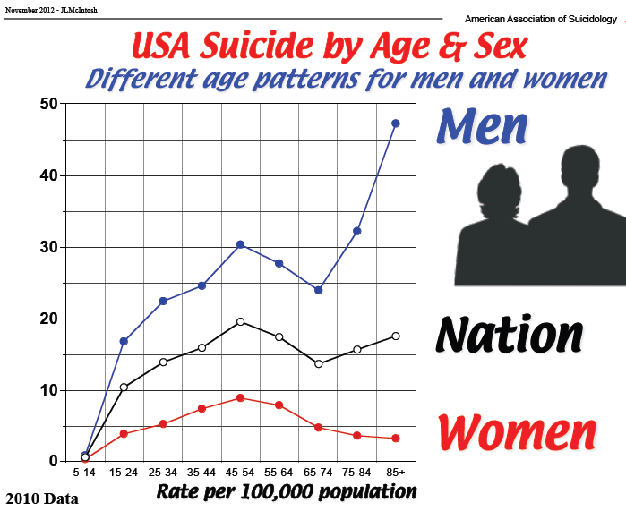
Stats by Age and Gender
Notes:
Suicide can occur as young as age 5. You can explain, if you want, about child devolvement and abstract thinking and how prior to that age children do not comprehend the finality of death. Explain that for both female and males rates increase from 35 to 54, but for males increase after 65. Ask tell me about what a male talks about versus a female and the understanding of purpose for a male when he retires. Explains part of the reasons for the differences.

Slide 20
Suicide Youth and Young Adults Rates
Age Number Rate
10-14 yrs. 425 2.1
15-19 yrs. 1,834 8.7
20-24 3,245 14.2
CDC 2014

Slide 21
Among students in grades 9-12 in the U.S. during 2013
• 17.0% of students seriously considered attempting suicide in the previous 12 months (22.4% of females and 11.6% of males).
• 13.6% of students made a plan about how they would attempt suicide in the previous 12 months (16.9% of females and 10.3% of males).
• 8.0% of students attempted suicide one or more times in the previous 12 months (10.6% of females and 5.4% of males).
• 2.7% of students made a suicide attempt that resulted in an injury, poisoning, or an overdose that required medical attention (3.6% of females and 1.8% of males).
CDC

Slide 22
Suicide by Race
In 2013, the highest U.S. suicide rate (14.2) was among Whites and the second highest rate (11.7) was among American Indians and Alaska Natives. Much lower and roughly similar rates were found among Asians and Pacific Islanders (5.8), Blacks (5.4) and Hispanics (5.7)

Slide 23
Suicide Rates Among VHA User Male Veterans and Non-Veteran Males in 23 States
Main Finding: Rates of suicide have increased among non-VHA user males and decreased among VHA user males. (Kemp & Bossarte, 2012)
Notes:
Explain about this study by the VA and males Veterans

Slide 24
Suicide Rates Among Middle Age (35-64 years) U.S. Adults and Users of VHA Services by Gender
Main Finding: In contrast to U.S. Males, rates of suicide among male VHA users aged 35-64 years have decrease (Kemp & Bossarte, 2012)
Notes:
Same here about decrease in males, but females did not decrease, but mirrored US females proportionally The VA is studying this effect.

Slide 25
Facts about Veteran suicide
18% of all deaths by suicide among U.S. adults were Veterans.
Veterans are more likely than the general population to use firearms as a means for suicide.⁴
On average, there are 764 suicide attempts per month among Veterans receiving recent VA health care services.⁵
25% of Veterans who died by suicide had a history of previous suicide attempts.⁵

Slide 26
Police Officers are also at Risk
Officers are 2-3 times more likely to die by their own hand than by a felonious murder on the job.
Between 13-18% of officers struggle with PTSD
91% were between the age of 40 to 44
Average years on the force 16
63% were single
Notice out of character behavior, sloppy work, late reports, carelessness, tardiness, or frequent sick days
Notes:
Police officers are also at risk… Notice that it typically isn’t the rookie. This also suggest that divorce rates are high.

Slide 27
Suicide Methods by Gender
Method | Men |  | Women
 | Men - Percent of Total | Men – Number of Suicides (30,277) | Women - Percent of Total | Women -Number of Suicides (8,087)
Firearms | 56.0% | 16,962 | 30.0% | 2,430
Hanging suffocation | 25.1% | 7,592 | 23.5% | 1,901
Poisons | 11.8% | 3,573 | 37.4% | 3,026
All other methods | 7.1% | 2,047 | 9.0% | 730
Suicide.org
Notes:
Explain why males have higher rates are also do to selection of means.

Slide 28
Suicide Prevention
Myths and Misinformation
Myth: Asking about suicide may lead a person to commit suicide
Reality:
Asking a person about suicide does not create suicidal
thoughts any more than asking about chest pain causes angina.
The act of asking the question simply gives the person permission to talk about his or her thoughts and feelings.
Notes:
Asking opens the door to speak with them, reduce stigma to MH and suicide

Slide 29
Suicide Prevention
Myths and Misinformation
Myth: There are ‘talkers’ and there are ‘doers’.
Reality:
Many individuals who die by suicide or attempt suicide have given some clue or warning. Someone who talks about suicide provides others with an opportunity to intervene before suicidal behaviors occur.
  Suicide threats should never be ignored. No matter how casually or jokingly said, statements like, "You'll be sorry when I'm dead," or "I can't see any way out" may indicate serious suicidal feelings.
Notes:
Myth:
There are talkers and there are doers
Reality:
Most people who die by suicide have communicated some intent. Someone who talks about suicide gives the guide and/or clinician an opportunity to intervene before suicidal behaviors occur.

Slide 30
Suicide Prevention
Myths and Misinformation
Myth: If somebody really wants to die by suicide, there is nothing you can do about it.
Reality:
Individuals who have survived serious suicide attempts have clearly stated that they wished someone had shown an interest.
By supporting the person to get help, you’ve gone a long way toward saving a life.
Notes:
Great time to see if they saw the movie “The Bridge” Explains Kevin Hines story of survival. If you have local data about bridge jumpers compare to SF bridge data and even though we are ranked in the top 40 worldwide, the GG is the number one location in the world for suicides.

Slide 31
Suicide Prevention
Myths and Misinformation
Myth: A person won’t commit suicide because…
  He just made plans for a vacation.
  She has young children at home.
  He made a verbal or written promise.
  She knows how dearly her family loves her
Reality:
  The intent to die can override any rational thinking.
  A suicidal person must be taken seriously and referred for evaluation and treatment.
Notes:
Having young children is not always a protective factor. They have to believe that the children cannot survive without them to be protective.
Explain why we have Safety plans and not to use no harm contracts

Slide 32
Suicide Prevention
Suicide Risk Factors
Factors that may INCREASE risk
  Current ideation, intent, plan, access to means
  Previous suicide attempt or attempts
  Alcohol/Substance abuse
  Previous history of psychiatric diagnosis
  Impulsivity and poor self control
  Hopelessness-presence, duration, severity
  Recent losses-physical, financial, personal

Slide 33
Suicide Prevention
Suicide Risk Factors
  Recent discharge from an inpatient unit
  Family history of suicide
  History of abuse (physical, sexual or emotional)
  Co-morbid health problems, especially a newly diagnosed problem or worsening symptoms increased pain
  Age, gender, race (elderly or young adult, unmarried, white, male, living alone)
  Same-sex sexual orientation

Slide 34
Suicide Prevention
Factors that may increase risks
Veteran specific risks:
  Frequent deployments
  Deployments to hostile environments
  Exposure to extreme stress
  Physical/sexual assault while in the service (not limited to women)
  Length of deployments
  Service related injury

Slide 35
Suicide Prevention
Signs of suicidal thinking
Acute Warning Signs and Symptoms:
    Threatening to hurt or kill self
    Looking for ways to kill self
    Seeking access to pills, weapons or other means
    Talking or writing about death, dying or suicide

Slide 36
Suicide Prevention
Signs of Suicidal Thinking
Additional Important Warning Signs:
  Hopelessness
  Rage, anger, seeking revenge
  Acting reckless or engaging in risky activities
  Feeling trapped
  Increasing drug or alcohol abuse

Slide 37
Suicide Prevention
Signs of Suicidal Thinking
Additional Important Warning Signs:
  Withdrawing from friends, family and society (Social Isolation)
  Anxiety, agitation
  Dramatic changes in mood
  Feeling there is no reason for living, no sense of purpose in life
  Difficulty sleeping or sleeping all the time
  Giving away possessions

Slide 38
Youth Warning Signs
Typically can be more subtle, but similar to adults
Signs of depression, such as moodiness, hopelessness, withdrawal
Hinting at not being around in the future or saying good-bye
a recent death or suicide of a friend or family member
news reports of other suicides by young people in the same school or community

Slide 39
Suicide Prevention
Psychosocial Stressors
Interpersonal Stressors
Conflict
    Marital Conflict
    Family Conflict
    Peer Conflict
    Workplace Conflict

Slide 40
Psychosocial Specific to Youth
a recent break-up with a boyfriend or girlfriend
conflict with parents

Slide 41
Suicide Prevention
What to ask?
Losses ,Trauma, and Conflict
Have you experienced any recent losses?
Has anything made you sad/angry/fearful recently?
How is your family life? Work? Retirement?
Social Functioning
Would you say you spend more time with yourself or with others? Why?
Do you enjoy doing things more with others or by yourself? How often?

Slide 42
Suicide Prevention
Psychosocial Stressors
Interpersonal Stressors
Loss
    Death of a loved one
    Divorce/Separation
    Relationship Breakup
    Loss of job (Retirement ,loss of Independence)
    Loss of home (declining health, assisted living, Retirement home)
    Major Financial loss (Retirement)
Notes:
Research is divided with job loss due to economic cycles

Slide 43
PROTECTIVE FACTORS
Protective factors, even if present, may not counteract significant acute risk
Internal: ability to cope with stress, religious beliefs, frustration tolerance, absence of psychosis
External: responsibility to children or beloved pets, positive therapeutic relationships, social supports
Ask: Is there anything that would prevent or keep you from harming yourself?

Slide 44
Suicide Prevention
Asking the Questionsking the question
Know how to ask the most important question of all:
Are you thinking of killing yourself?
Or
Do you have thoughts about taking your own life?

Slide 45
Suicide Prevention
Asking the Questionsking the question
DO ask the question if you’ve identified warning signs
or symptoms
DO ask the question in such a way that is natural and
flows with the conversation
DON’T ask the question as though you are looking for a
“no” answer. “You aren’t thinking of killing yourself are you?”

Slide 46
Suicide Prevention
Asking the Questionsking the question
Things to consider when you talk with the person:
  Remain calm
  Listen more than you speak
  Maintain eye contact
  Act with confidence
  Do not argue
  Use open body language
  Limit questions-let the person do the talking
  Use supportive - encouraging comments
  Be honest –there are no quick solutions but
help is available

Slide 47
Suicide Prevention
Validate the person’s experience
Validation means:
Acknowledging the person’s feelings
Recognizing that the situation is serious
Not passing judgment
Reassuring him or her that you are here to help

Slide 48
Suicide Prevention Encourage treatment and Expedite getting help
Reassure the person that:
  Treatment is available
  Getting help for thoughts of suicide is like getting help for any medical problem
  Every Person has the right to care
  Even if they have had treatment before, it’s worth it to try again

Slide 49
Suicide Prevention
VETERANS CRISIS LINE
1-800-273-TALK
1-800-273-8255
for Veterans Press “1”
SC United Way
211

Slide 50
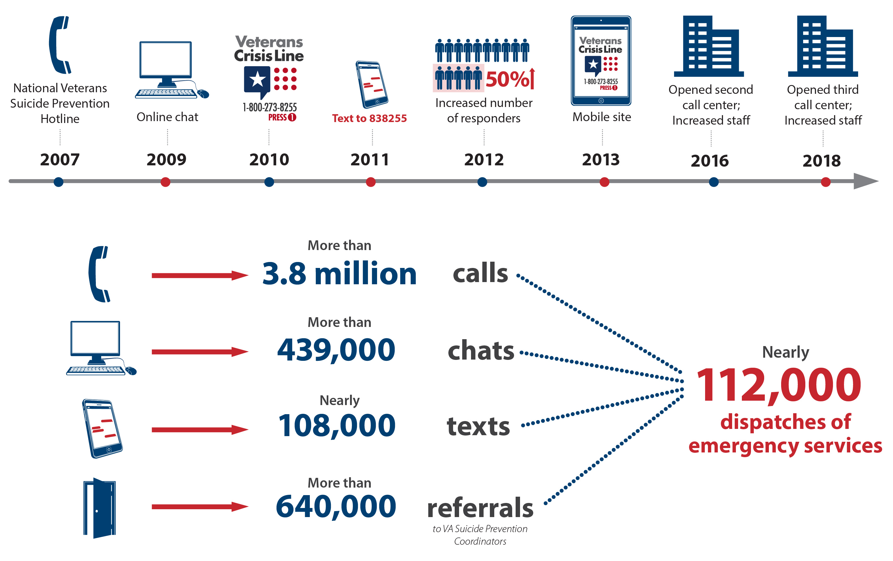

Slide 51
Assessment

Slide 52
Assessment Guide
What to Ask
Suicide Inquiry: Specific questioning about thoughts, plans,
behaviors, intent
Ideation: frequency, intensity, duration--in last 48 hours
Plan: timing, location, lethality, availability, preparatory acts
Behaviors: past attempts, aborted attempts, rehearsals (tying noose, loading gun), vs. non-suicidal self injurious actions
Intent: extent to which the person
(1) expects to carry out the plan and
(2) believes the plan/act to be lethal vs. self-injurious
Explore ambivalence: reasons to die vs. reasons to live
Homicide Inquiry: when indicated

Slide 53
Assessment Guide
What to Ask
Ask The Question?
Have you had thoughts about taking
your own life?
When did you have these thoughts?
Do you have a plan to take your life?
Are you feeling hopeless about the
present and/or future?
Have you ever had a suicide attempt?

Slide 54
Assessment for Depression
Geriatric Depression Scale (GDS) Age 65+
30 questions ; short form 15 questions
Do you think it is wonderful to be alive now?
(phone apps available)
Children’s Depression Inventory (CDI) Ages 7 to 17
27 or 10 item (short version)
BDI II 21 questions up to 80, there is a youth version Ages 7 to 18
Suicidal thoughts or wishes
PHQ9 Ages 13 to 65+
Thoughts that you would be better off dead or hurting yourself in some way
(phone apps available)

Slide 55
Scales for Assessing Suicide
Beck Hopelessness Scale ages 17-80
Columbia Suicide Severity Scale (diff versions)
Beck Scale for Suicide Ideation 17 and older
Implicit Association Test-Suicide
Ask Suicide Screening Questions (ASQ) ages 10-21

Slide 56
Treatment for Suicidal Ideation
Dialectical Behavior Therapy (DBT) Linehan
Components of CBT, Reality Testing with concepts of distress tolerance, and Mindfulness introduced in individual sessions
Group sessions address Skills related to mindfulness, interpersonal effectiveness, emotion regulation and distress tolerance.

Slide 57
Treatment for Suicidal Ideation
Collaborative Assessment and Management of Suicidality (CAMS) Jobes
SSF IV (Initial, Tracking and Outcome)
Rate Psych Pain, Stress, Agitation, Hopelessness, Self-hate, and Overall Risk
Complete diagnostic on initial including TX plan
Key Components are Reviewed and tracked during sessions

Slide 58
Cognitive Therapy for Suicidal Patients (CT_SP)
Based on Dr. Arron Beck’s Cognitive behavioral model
biopsychosocial vulnerabilities can interact with suicidal thoughts and behaviors to produce a “suicide mode”.
follows a session structure consistent with a typical CBT session
focuses on treatment engagement, risk assessment, and crisis management (Safety Planning, Means Restriction using collaboration
Moves toward developing effective coping skills and are taught to evaluate their thoughts and beliefs an d modifying core beliefs
Finally includes relapse prevention strategies

Slide 59
Safety Plan
Suicide Prevention

Slide 60
Introduction to the Suicide Safety Plan
No harm contracts…do not work
It is a brief clinical intervention
It can serve as a valuable adjunct to a risk assessment
It is a prioritized written list of coping strategies and sources of support
It provides a pre-determined list of potential coping strategies and a list of agencies and individuals for contact
Rudd, Mandrusiak, & Joiner (2006);Stanley & Brown (2008)

Slide 61
Suicide Prevention
Safety Plan
The Effects of the Use of "No-Suicide Contracts" in Community Crisis Situations: The Experience of Clinicians and Consumers
Tony L. Farrow; Alexander I. F. Simpson; Helen B. Warren
Brief Treatment and Crisis Intervention; Sep 1, 2002; 2, 3; Research Library
pg. 241
The Case Against No-Suicide Contracts: The Commitment to Treatment Statement as a Practice Alternative
M. David Rudd, Michael Mandrusiak, Thomas E. Joiner Jr.
Journal of Clinical Psychology: In session, Vol. 62(2), 243–251 (2006)

Slide 62
Developing a Suicide Safety Plan
Typically should be done after a risk assessment
Collaboration is improved when sitting side by side
Use a problem solving approach
Focus specifically on the Safety plan
Stanley & Brown (2008); Jobes (2006)

Slide 63
Basic Components of a Safety Plan
1) Recognizing warning signs that are proximal to an impending suicidal crisis.
2) Identifying and employing internal coping strategies without needing to contact another person.
3) Utilizing contacts with people as a means of distraction from suicidal thoughts and urges. This includes going to healthy social settings, such as a coffee shop or place of religion or socializing with family members or others who may offer support without discussing suicidal thoughts.

Slide 64
Basic Components of a Safety Plan
4) Contacting family members or friends who may help to resolve a crisis and with whom Suicidality can be discussed.
5) Contacting mental health professionals or agencies.
6) Reducing the potential for use of lethal means.
Safety Plan Treatment Manual to Reduce Suicide Risk: Veteran Version
Barbara Stanley, Ph.D. and Gregory K. Brown, Ph.D.
In collaboration with Bradley Karlin, Ph.D., Janet E. Kemp, Ph.D.
and Heather A. VonBergen, Ph.D.

Slide 65
Suicide Prevention
“The suffering of the suicidal is private and inexpressible, leaving family members, friends, and colleagues to deal with an almost unfathomable kind of loss, as well as guilt. Suicide carries in its aftermath a level of confusion and devastation that is, for the most part, beyond description.”
Kay Redfield Jamison

Slide 66
References
American Psychiatric Association. Practice guideline for the assessment and treatment of patients with suicidal behaviors. Am J of Psychiatry 160:1-60, Nov. 2003.
Jobes, D. A. (2006). Managing suicidal risk: A collaborative approach. New York: Guilford
Huang C., BiRong, D., Zhen-Chan, L., Yuan, z., Yu-Sheng, P., &Qing-Xiu, L. Collaborative care interventions for depression in the elderly: A systematic review of Randomized controlled trials. Journal of Investigative Medicine 57 (2) Feb 2009.
Kemp, J & Bossarte, R Suicide Data Report, 2012 Department of Veterans Affairs, Mental Health Services, Suicide Prevention Program
Mellqvist, M, Wiktorsson, S., Joas, E., Svante, O., Ingmar, S. & Waern, M. Sense of coherence in elderly suicide attempters: The impact of social and health-related factors. International Psychogeriatrics 23:6 986-993, 2011.
Operation S.A.V.E. Guide Training VA Edition Dr. Kerry Knox, Dr. Jan Kemp, Dr. Deborah King & Jane Wood
National Center for Injury and Prevention Control. WISQARS (Web-based Injury Statistics Query and Reporting System). http://www.cdc.gov/ncipc/wisqars/ accessed Dec 2012.
Rudd, D.M, Mandrusiak, M., & Joiner Jr., T. E. (2006) The Case Against No-Suicide Contracts: The Commitment to Treatment Statement as a Practice Alternative Journal of Clinical Psychology: Vol. 62(2), 243–251
Stanley, B. & Brown, G. K. (2008). The Safety Plan Treatment Manual to Reduce Suicide Risk: Veteran Version. Washington, D.C.: United States Department of Veterans Affairs.

Slide 67
References and Informational Websites
http://www.cdc.gov/violenceprevention/suicide/statistics/
http://vaww.mentalhealth.va.gov/suicide.asp
http://mentalhealth.samhsa.gov/suicideprevention/elderly.asp
http://www.ncbi.nlm.nih.gov/pmc/articles/PMC3107573
http://suicide.org/elderly-suicide.html
http://suicidepreventionlifeline.org/

Slide 68
Questions

