Slide 1
Engaging Patients Who Struggle to Engage
Jeremy Martin, LMSW

Slide 2

Disclosures
Fundamentals: Concurrent Disorders
I have no actual or potential conflict of interest in relation to this presentation

Slide 3
Learning Objectives
Fundamentals: Concurrent Disorders
Gain an understanding of how the change continuum effects overall engagement
Expand knowledge around stages of change and how they effect treatment
Achieve a greater understanding of how to engage with patients who are reluctant to engage
Develop an understanding of how to use Motivational Interviewing to motivate patients along the change continuum
Notes:
The extent of material is so vast, I tried to narrow it down to the essential information.

Slide 4
Motivation to change…
Think of a difficult situation you have faced in your life that forced you to consider a change
What was difficult about the situation?
What emotions or feelings were tied to that event?
What obstacles did you face?
What outcome were you hopeful for?
What outcome was actually achieved?

Slide 5
Difficult to engage patients
Fundamentals: Concurrent Disorders
Individuals who:
Refuse to follow or work on treatment plans
Consistently miss appointments
Do not follow-up with referrals or other providers
Refuse to complete homework, tests, or other procedures
Do not openly share about their struggles or are dishonest
Self-sabotage or sabotage the treatment of others
Notes:
The extent of material is so vast, I tried to narrow it down to the essential information.

Slide 6

Difficult to engage patients
How many of you work only with individuals who are fully committed to change?
How may of you, when faced with change, are fully committed with no reservations or fears?

Slide 7
It is not always the patient’s fault
Fundamentals: Concurrent Disorders
Individuals may face internal or external obstacles to their success
It is our responsibility to be vigilant for these
Some examples include TBI, literacy issues, environmental factors like domestic violence, transportation challenges, neurodevelopmental delays
According to a national survey, more than one-third of the adult population have basic or below basic health literacy levels
Notes:
The extent of material is so vast, I tried to narrow it down to the essential information.

Slide 8
It is not always the patient’s fault
Fundamentals: Concurrent Disorders
Some examples of low health literacy include:
Incomplete registration forms
Unable to provide coherent personal and family medical history
Limited English language skills and lack of translation services
Not keeping scheduled appointments
Asking few questions and just agreeing with the clinician
Not following treatment plans
Notes:
The extent of material is so vast, I tried to narrow it down to the essential information.

Slide 9
It is not always the patient’s fault
Fundamentals: Concurrent Disorders
Patients who report a difficult encounter with a clinician report they:
Trust their clinicians less
Have more unmet expectations
Have lower satisfaction with their clinicians
Patients with unaddressed medical conditions such as anxiety and depression may frequently appear as if they are difficult to engage
Difficult encounters cause stress and damage to the therapeutic relationship for everyone involved
Notes:
The extent of material is so vast, I tried to narrow it down to the essential information.

Slide 10

Expectations and how they affect motivation
Patients have expectations of what their experience will be like in treatment
When expectations are not met, patients are frequently disappointed and lose faith in the clinician or organization
We can help manage those expectations by discussing them and helping reframe them when needed
Notes:
Continuing with the house on fire analogy…
Review these bullets and related them to providing treating and recovery services to individuals with SUDs and keeping the fire extinguished and the processes of rebuilding the house.
The SUD field has been less successful in:
Preventing relapse
Helping the individual create plans to reconstruct their life (comprehensive treatment planning with more than one agency)
Providing guidance, direction, and support to increase recovery capital
Helping and advocating for individuals to navigate difficult systems that might have barriers
White’s paper listed below has a list of steps that the SUD field can do to increase recovery capital which are not listed here.
Kelly, J.F., Greene, M.C., & Bergman, B.G. (2018). Beyond abstinence: Changes in indices of quality of life with time in recovery in a nationally representative sample of U.S. adults. Alcoholism: Clinical & Experimental Research, 42(4), 770-780.
White, W.L. (2018, June 18). Quality of Life in Early Recovery and Beyond. (Blog Post). Retrieved from http://www.williamwhitepapers.com/blog/2018/06/quality-of-life-in-early-recovery-and-beyond.html 1/3

Slide 11
Why change can be difficult
Fear – fear of the unknown or the different, of not knowing how process will play out, of how others might react, and what this change might cost us
Conflict – for most people there is some level of conflict when change occurs, this might be internal or external conflict
Surprise – frequently change catches us off guard and we are forced to confront a new path
Change – most people are uncomfortable with change, we all differ in our level of discomfort and how we express it

Slide 12
Why we avoid change
We are afraid we cannot achieve the desired outcome
We do not want to feel bad or make others feel bad
We may be forced to face realizations we are not prepared for
We may have to confront difficult emotions and feelings
We fear the consequences of our current state or of the change we are faced with

Slide 13
Change…
Why is it that most people know what they should be doing, but are not actually doing it?
Change is harder than the alternative; we are more comfortable with what we are used to
Change is one of the most difficult things to do – and lasting change is even harder
Change is a gradual evolution in thought process and action
Making a lasting change in behaviour is rarely a simple

Slide 14
Change…
Change does not roll in on the wheels of inevitability, but comes through continuous struggle – Martin Luther King, Jr.
Change is hardest in the beginning, messiest in the middle, and best at the end – Robin Sharma
The secret to change is to focus all of your energy, not on fighting the old, but on building the new – Socrates
Life does not get better by chance. It gets better by change – Jim Rohn

Slide 15
Stages of Change
Meeting patients where they are at

Slide 16
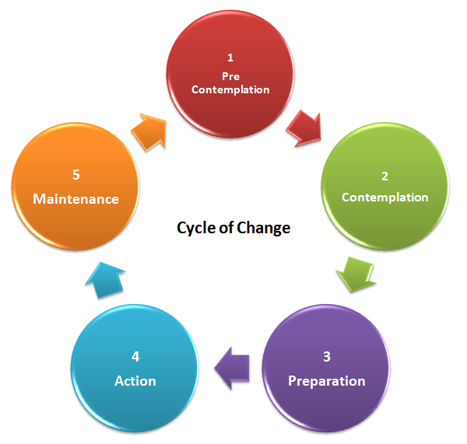
Stages of change
The model was developed by Prochaska & DiClemete (1983)
It suggests that behavior changes does not happen in one step
Change tends to happen through stages the build towards successful and lasting change

Slide 17

So why discuss Stages of Change?
Understanding the process of change and being able to identify where your patients is in the change process allows choice in the use of engagement techniques and practices

Slide 18
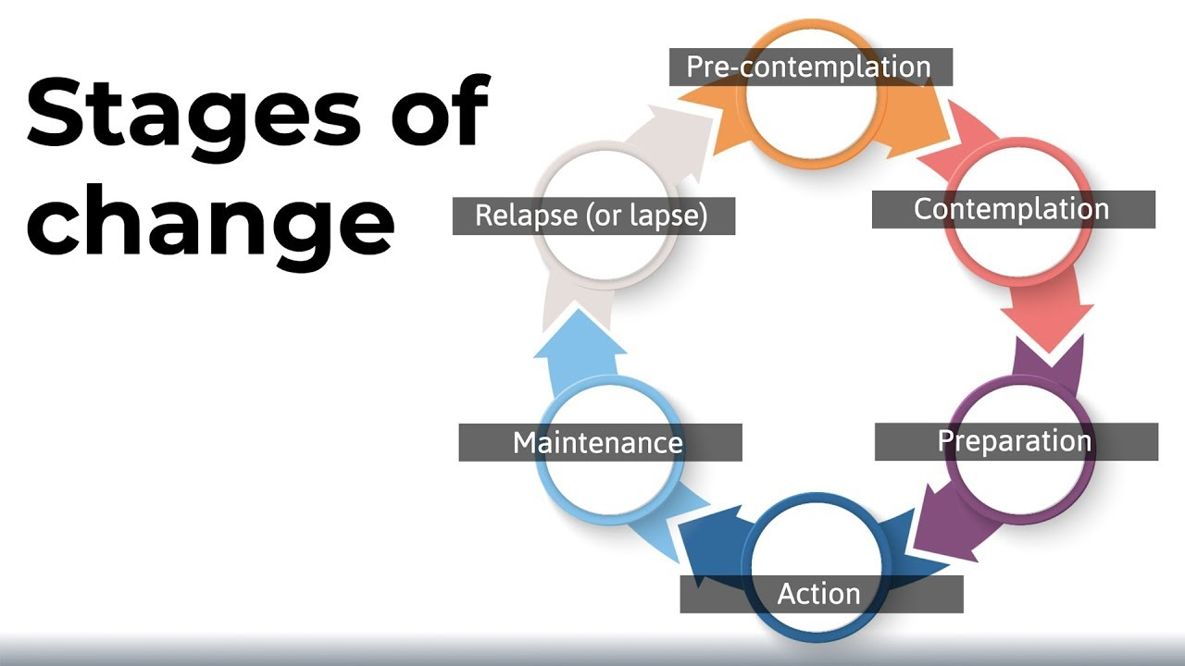
Transtheoretical Model of Change
(Prochaska & DiClemente, 1983)

Slide 19
Precontemplation
The individual is unaware, unable, and/or unwilling to change
No intention for behavior change in the foreseeable future
“No problems, I’m fine as I am”
Indicators - argue, interrupt, deny, ignore, avoid reading, talking about, or thinking about the behavior…
The individual is traditionally characterized as resistant, unmotivated
Denial is not always a reality

Slide 20
Contemplation
The individual is ambivalent or uncertain regarding behavior change
Not quite yet ready or committed to make a change
Starting to weigh the pros and cons of modifying behavior and/or thoughts
“I can’t do what I used to; I need to change”
Indicators – meets the clinician “half way,” willing to look at pro and cons of behavior change
Individual is traditionally characterized as unpredictable, time intensive

Slide 21
Preparation
The individual shifts from thinking about behavior change to planning first steps
Getting ready to change
May experiment with small changes
“I think I need to talk with someone about this, I think I will schedule an appointment with someone”
Indicators – asks questions, considers options, demonstrates openness in considering behavior change.
The individual is traditionally characterized as compliant, “coming along,”, “good to work with”

Slide 22
Action
The individual demonstrates steps toward behavior change such as periods of abstinence
They believe they have the ability to change their behavior
“Three therapy sessions, I am starting to feel much better”
Indicators –receptive to clinical interventions, treatment adherence is as expected, demonstrated behavior change affects positive outcomes in other areas (i.e., relationships at home and work)
The individual is traditionally characterized as “successful,” “working the program”

Slide 23
Maintenance
The individual sustains treatment goals
Successfully avoiding temptations to return to the negative habit
“I’m attending regularly, and rarely miss a session”
Indicators - has made behavior changes, practices stable abstinence, met treatment goals, and practices healthy coping strategies
The individual is traditionally characterized as “ready for successful discharge,” “no longer needing treatment,” and “ready for aftercare”

Slide 24
Relapse…..Recurrence
‘Slipping back’ into old habits, this can occur at any stage
Common feature of sustained change
Most recurrences happen before maintenance is achieved)
Can be discouraging for the person
Presents an opportunity to learn and develop more skill/experience
Look at reaffirmation of goals

Slide 25
Stages of Change Principles
Motivation exists along a continuum of change
Patients progress through stages in a spiral (not linear)
When enhancing motivation, if the clinician uses strategies in a stage other than the one the patient is in, the result could be treatment ambivalence and/or nonadherance
If clinicians push patients at a faster pace than they are willing to take, the therapeutic alliance may break down
Relapse/Recurrence is an event, not a stage

Slide 26

Why is this important?
Allows you to assist with ‘assessing’ the stage an individual is in
Helps you to present information appropriate for each stage
Helps you to reassure the person their challenges are a normal part of change
Notes:
This analogy appears in the article by John Kelley and colleagues and is useful when discussing recovery and recovery capital.
Much of the current SUD research demonstrates that professionals understand how to initially stop substance use, meaning that these professionals know how to medically detox someone from opioids, alcohol, and other sedative hypnotics, and ensure that the patient is clinically stable. Medical professionals can effectively treat overdoses in many cases and stabilize the patients. This wasn’t true 50 years ago so advancements have been made. The next slide discusses the challenges behavioral health professionals continue to face with individuals with SUDs post detoxification.
Kelly, J.F., Greene, M.C., & Bergman, B.G. (2018). Beyond abstinence: Changes in indices of quality of life with time in recovery in a nationally representative sample of U.S. adults. Alcoholism: Clinical & Experimental Research, 42(4), 770-780.
White, W.L. (2018, June 18). Quality of Life in Early Recovery and Beyond. (Blog Post). Retrieved from http://www.williamwhitepapers.com/blog/2018/06/quality-of-life-in-early-recovery-and-beyond.html 1/3

Slide 27
How to respond
Precontemplation—information
Contemplation—options on how to change behaviors/thoughts
Preparation—assistance in setting goals and timelines
Action—support in implementing the plan
Maintenance—promoting the continuation of goal directed behavior/choices/thoughts
Relapse/Recurrence—reaffirming goals and commitment to change
Notes:
This slide reinforces the point that recovery is not just about abstinence but about improvements in all areas of an individual’s life. The concept of Recovery Capital (defined and discussed later) helps build that case.
Kelly, J.F., Greene, M.C., & Bergman, B.G. (2018). Beyond abstinence: Changes in indices of quality of life with time in recovery in a nationally representative sample of U.S. adults. Alcoholism: Clinical & Experimental Research, 42(4), 770-780.
White, W.L. (2018, June 18). Quality of Life in Early Recovery and Beyond. (Blog Post). Retrieved from http://www.williamwhitepapers.com/blog/2018/06/quality-of-life-in-early-recovery-and-beyond.html 1/3

Slide 28
How to respond…Precontemplation
Establish rapport
Determine why they have come to you
Introduce ambivalence about change – why it might be a good idea
“Why do you think other people decide to makes these types of changes?”
Give information on risks, pros and cons
Acknowledge the patient’s thoughts, feelings, fears, and concerns
Keep the interview informal
Notes:
Continuing with the house on fire analogy…
Review these bullets and related them to providing treating and recovery services to individuals with SUDs and keeping the fire extinguished and the processes of rebuilding the house.
The SUD field has been less successful in:
Preventing relapse
Helping the individual create plans to reconstruct their life (comprehensive treatment planning with more than one agency)
Providing guidance, direction, and support to increase recovery capital
Helping and advocating for individuals to navigate difficult systems that might have barriers
White’s paper listed below has a list of steps that the SUD field can do to increase recovery capital which are not listed here.
Kelly, J.F., Greene, M.C., & Bergman, B.G. (2018). Beyond abstinence: Changes in indices of quality of life with time in recovery in a nationally representative sample of U.S. adults. Alcoholism: Clinical & Experimental Research, 42(4), 770-780.
White, W.L. (2018, June 18). Quality of Life in Early Recovery and Beyond. (Blog Post). Retrieved from http://www.williamwhitepapers.com/blog/2018/06/quality-of-life-in-early-recovery-and-beyond.html 1/3

Slide 29
How to respond…Contemplation
Discuss and weigh pros/cons
Emphasize the patient’s free choice & responsibility
Elicit self-motivational statements
Discuss the patient’s goals in life and how will change affect these?
Reduce the fear of change through examples and problem solving
Ask questions that clarify motivation
“What’s most important to you… why?”
Notes:
Continuing with the house on fire analogy…
Review these bullets and related them to providing treating and recovery services to individuals with SUDs and keeping the fire extinguished and the processes of rebuilding the house.
The SUD field has been less successful in:
Preventing relapse
Helping the individual create plans to reconstruct their life (comprehensive treatment planning with more than one agency)
Providing guidance, direction, and support to increase recovery capital
Helping and advocating for individuals to navigate difficult systems that might have barriers
White’s paper listed below has a list of steps that the SUD field can do to increase recovery capital which are not listed here.
Kelly, J.F., Greene, M.C., & Bergman, B.G. (2018). Beyond abstinence: Changes in indices of quality of life with time in recovery in a nationally representative sample of U.S. adults. Alcoholism: Clinical & Experimental Research, 42(4), 770-780.
White, W.L. (2018, June 18). Quality of Life in Early Recovery and Beyond. (Blog Post). Retrieved from http://www.williamwhitepapers.com/blog/2018/06/quality-of-life-in-early-recovery-and-beyond.html 1/3

Slide 30
How to respond…Preparation
Support efforts to change
Clarify goals and identify successful strategies
Structure a plan of action with the patient based on their history and willingness, allowing them to shape the plan
Encourage the patient to commit to action
Provide clear, consistent and unequivocal messages about the positive things change can bring
Notes:
Continuing with the house on fire analogy…
Review these bullets and related them to providing treating and recovery services to individuals with SUDs and keeping the fire extinguished and the processes of rebuilding the house.
The SUD field has been less successful in:
Preventing relapse
Helping the individual create plans to reconstruct their life (comprehensive treatment planning with more than one agency)
Providing guidance, direction, and support to increase recovery capital
Helping and advocating for individuals to navigate difficult systems that might have barriers
White’s paper listed below has a list of steps that the SUD field can do to increase recovery capital which are not listed here.
Kelly, J.F., Greene, M.C., & Bergman, B.G. (2018). Beyond abstinence: Changes in indices of quality of life with time in recovery in a nationally representative sample of U.S. adults. Alcoholism: Clinical & Experimental Research, 42(4), 770-780.
White, W.L. (2018, June 18). Quality of Life in Early Recovery and Beyond. (Blog Post). Retrieved from http://www.williamwhitepapers.com/blog/2018/06/quality-of-life-in-early-recovery-and-beyond.html 1/3

Slide 31
How to respond…Action
Seek commitment to specific behavioral change at each session
Acknowledge difficulties, support all progress even small gains
Identify risky situations, triggers and coping strategies
Help the patient find new reinforcers
Support perseverance
“Sticking to the plan”
Notes:
Continuing with the house on fire analogy…
Review these bullets and related them to providing treating and recovery services to individuals with SUDs and keeping the fire extinguished and the processes of rebuilding the house.
The SUD field has been less successful in:
Preventing relapse
Helping the individual create plans to reconstruct their life (comprehensive treatment planning with more than one agency)
Providing guidance, direction, and support to increase recovery capital
Helping and advocating for individuals to navigate difficult systems that might have barriers
White’s paper listed below has a list of steps that the SUD field can do to increase recovery capital which are not listed here.
Kelly, J.F., Greene, M.C., & Bergman, B.G. (2018). Beyond abstinence: Changes in indices of quality of life with time in recovery in a nationally representative sample of U.S. adults. Alcoholism: Clinical & Experimental Research, 42(4), 770-780.
White, W.L. (2018, June 18). Quality of Life in Early Recovery and Beyond. (Blog Post). Retrieved from http://www.williamwhitepapers.com/blog/2018/06/quality-of-life-in-early-recovery-and-beyond.html 1/3

Slide 32
How to respond…Maintenance
Support and affirm changes
Rehearse new coping strategies and countermeasures to triggers
Review personal growth and long-term goals
Encourage the patient to support others in their positive change
Notes:
Continuing with the house on fire analogy…
Review these bullets and related them to providing treating and recovery services to individuals with SUDs and keeping the fire extinguished and the processes of rebuilding the house.
The SUD field has been less successful in:
Preventing relapse
Helping the individual create plans to reconstruct their life (comprehensive treatment planning with more than one agency)
Providing guidance, direction, and support to increase recovery capital
Helping and advocating for individuals to navigate difficult systems that might have barriers
White’s paper listed below has a list of steps that the SUD field can do to increase recovery capital which are not listed here.
Kelly, J.F., Greene, M.C., & Bergman, B.G. (2018). Beyond abstinence: Changes in indices of quality of life with time in recovery in a nationally representative sample of U.S. adults. Alcoholism: Clinical & Experimental Research, 42(4), 770-780.
White, W.L. (2018, June 18). Quality of Life in Early Recovery and Beyond. (Blog Post). Retrieved from http://www.williamwhitepapers.com/blog/2018/06/quality-of-life-in-early-recovery-and-beyond.html 1/3

Slide 33
Ambivalence is…
Simultaneously wanting and not wanting something
Or
Wanting two incongruent things
A normal part of the change process
Frequently the hallmark of the Contemplative Stage of Change
We find our way out of ambivalence by choose a path, following it, and continuing to move in the direction of that path

Slide 34
Ambivalence
Frequently we hear Change talk and Sustain talk all mixed together when individuals are ambivalent
Change talk – the patient’s statements favor change, often seen as self-motivating statement
“I know I should stop using substances to improve my quality of life”
Sustain talk – the opposite of change talk, the patient’s own arguments for not changing or language geared towards maintaining their current position
“I know substances are bad for my health, but I cannot imagine life without them”

Slide 35
Listening for change talk
Cognitive Recognition of the problem
"I guess this is more serious than I thought"
Affective Expression of concern about the perceived problem
"I'm really worried about what is happening to me"
A Direct or Implicit Intention to change behavior
"I've got to do something about this"
Optimism about one's ability to change
"I know that if I try, I can really do it"

Slide 36
Four major categories of patient resistance behavior
Arguing - The patient contests the accuracy, expertise, or integrity of the clinician or organization
Interrupting - The patient breaks in and interrupts the clinician in a defensive manner
Negating- The patient expresses unwillingness to recognize problems, cooperate, accept responsibility, or take advice
Ignoring - The patient shows evidence of ignoring or not following the clinician

Slide 37
So how do we overcome the challenges?
Engagement!
Engagement is the initial foundation from which a clinician can support a patient in the change process
Engagement is establishing a working relationship built upon a supportive connection between the patient and clinician
Engagement is the first step in a relationship that builds towards a goal or focus

Slide 38

Common traps to avoid
Question/Answer trap or the Assessment trap
Confrontation/Denial trap
Expert trap
Labeling trap
Premature focus trap
Blaming trap

Slide 39
Motivational Interviewing
An evidence-based practice to supporting engagement

Slide 40
What is Motivational Interviewing
“Motivational Interviewing is a collaborative, goal-oriented style of communication paying particular attention to the language of change. It is designed to strengthen personal motivation for and commitment to a specific goal by eliciting and exploring the person's own reasons for change within an atmosphere of acceptance and compassion.”
A directive, patient-centered engagement style for eliciting behavior change by helping patients explore and resolve ambivalence
Designed to produce rapid, internally motivated change by mobilizing the patient’s own change resources
(Miller and Rollnick, 1991)

Slide 41
Evolution and foundations of MI
There are currently more than 1,200 publications documenting MI’s use and effectiveness
The initial focus of MI was rooted in working with individuals with substance use disorders
More recent research has demonstrated its effectiveness in areas such as healthcare, corrections, and working with youth

Slide 42

Core beliefs of MI
Motivation to change is elicited from the patient, and not imposed from without
It is the patient's task, not the clinician’s, to articulate and resolve their ambivalence
Direct persuasion is not effective in resolving ambivalence

Slide 43
Core beliefs of MI
The clinician is directive in helping the patient to examine and resolve ambivalence
Readiness to change is not a patient trait, but a fluctuating product of interpersonal interaction
Emphasis on freedom of choice rather than the clinician as the expert

Slide 44

What is Motivational Interviewing
NOT persuasion
NOT advice giving
It is:
Open-ended questions
Affirmations
Reflective listening
Summaries

Slide 45
What is Motivational Interviewing
Patient determines the change or treatment plan
Avoid unsolicited advice
Involves the best basic interpersonal skills:
Express empathy
Use good nonverbal listening skills
Problem solving partners

Slide 46
Four general principles of MI
Expressing empathy:
Acceptance facilitates change
It is not the same as agreement or approval
It does not prohibit the clinician from disagreeing with the patient and expressing that disagreement
Ambivalence is a normal part of the human experience and change process

Slide 47
Four general principles of MI
Expressing empathy:
Empathy communicates acceptance, while supporting the process of change
Acceptance facilitates change
Clinicians seek to build up rather than tear down
Skillful reflective listening is fundamental to expressing empathy

Slide 48
Four general principles of MI
Developing discrepancy:
The goal is to assist the patient in changing their perceptions without creating a sense of being pressured or coerced
People are more persuaded by what they hear themselves say, rather than what they hear others tell them
The patient should present the arguments for change, not the clinician
Change is motivated by a perceived discrepancy between present behavior/situation and the patients goals and values

Slide 49
Four general principles of MI
Developing discrepancy:
Motivation for change is enhanced when patient perceives differences between their current situation and their hopes for the future
Developing awareness of consequences helps patients examine their behavior
A discrepancy between present behavior and important goals motivates change
The patient should present the arguments for change

Slide 50
Four general principles of MI
Rolling with Resistance or Dancing with Discord:
Resistance is a signal to respond differently and chose a different path
Avoid arguing for change, it rarely works
Resistance is not directly opposed, instead we may shift the focus
New perspectives are invited by not imposed on the patient
The patient is the primary resource in finding answers and solutions

Slide 51
Four general principles of MI
Dancing with discord:
Momentum can be used to good advantage
Perceptions can be shifted
New perspectives are invited but not imposed
The patient is a valuable resource in finding solutions to problems

Slide 52
Four other guiding principles of MI
Resist the righting reflex:
Tendency to set the person on the right path
Offering single alternatives may yield a “yes, but” response
When the patient is ambivalent to change and the clinician pushes for change regardless
Understanding motivation:
We achieve more by asking patients what their reasons are and why they choose to change rather than trying to push them to change

Slide 53
Four other guiding principles of MI
Listen to the patient:
The answers most likely lie within the patient
We cannot help the patient find these answers without listening
Empower your patient:
Patients who are actively involved in their change process are more likely to create lasting change

Slide 54
MI Skills
Open-ended questions:
Helps you understand your patients' point of view
Elicits their feelings about a given topic or situation
Facilitate dialog
They cannot be answered with a single word or phrase
Do not require any particular response

Slide 55
MI Skills
Reflective listening:
Is a way of checking rather than assuming that you know what is meant
Allows patients to hear their thoughts and feelings and to consider them
Affirming:
When it is done sincerely, affirming your patient supports and promotes self-efficacy
Recognizing strengths, abilities, good intentions, and efforts of the individual

Slide 56
MI Skills
Simple reflection:
The simplest approach to responding to resistance is with nonresistance
Repeating the patient's statement in a neutral form
This acknowledges and validates what the patient has said and can elicit an opposite response

Slide 57
MI Skills
Shifting Focus:
You can defuse resistance by helping the patient shift focus away from obstacles and barriers
This method offers an opportunity to affirm your patient's personal choice regarding the conduct of their own life

Slide 58
MI Skills
Reframing:
A good strategy to use when a patient denies personal problems
Offering a new and positive interpretation of negative information provided by the patient
Reframing acknowledges the validity of the patient's raw observations, but offers a new meaning

Slide 59
MI Skills
Self-efficacy:
The belief that one can perform a behavior or accomplish a particular task
Belief in the possibility of change is an important motivator
The patient is responsible for choosing and carrying out personal change
There is hope in the range of alternative approaches available

Slide 60
MI Skills
Avoiding arguments:
Arguments are counterproductive
Defending breeds defensiveness
Resistance is a signal to change strategies
Labeling is unnecessary

Slide 61
Summary for success
Patients are experts on themselves
Begin with finding out what they know and what they might need to know
Engagement style and information provided will vary based upon the patient’s state of change
Advice that meets the patients needs can be helpful

Slide 62
Summary for success
Motivational Interviewing training is only the beginning
Experience, feedback, and coaching help build proficiency
Skill can decline over time
Utilizing MI effectively is an ongoing process of education and implementation

Slide 63


Slide 64
Thank you!
Questions??

