Slide 1
Opioid Use Disorder and MAT
John Emmel, MD
Medical Director, DAODAS and Charleston Center
jemmel@charlestoncounty.org

Slide 2
INTRODUCTION
There is a serious opioid epidemic
It’s not the first one we’ve had
400,000 people have died since 1999
Any measures that can affect the continued staggering death rate are worth considering

Slide 3
INTRODUCTION (history)
Today’s subject: opioid use disorder
Opioid drugs used for thousands of years
Medicine has used them for hundreds of years
Prescription of opioids regulated since Harrison Narcotic Act
People have “misused” opioids for as long as they’ve been around
But in the last 15-20 years: epidemic of opioid addiction

Slide 4
Contributors to the epidemic
Human “nature”/genetics
Availability of Rx opioids, at least partially due to the “enlightening” of physicians in the 1990s about our inadequate treatment of pain, accompanied by unprecedented pharmaceutical company marketing of opioids
Availability of purer heroin, making intranasal use an effective route of use, which vastly increased the number of willing users
More recently, fentanyl, much more potent and potentially less expensive

Slide 5
Race/Ethnicity
Rates of overdose, both from “traditional” and new synthetic (fentanyl, et al) opioids, increased dramatically 2015 to 2017 in ALL categories in all Metropolitan Service Areas
Of these, African Americans had the largest increase
Hispanics had the next highest
Whites had the least increase during this time period
These increases occurred in all age groups

Slide 6
LGBT and Opioids
2015 - LGB misuse of Rx pain relievers 10.4% vs 4.5% in heterosexuals
2018 - LGB illicit opioid use 9.8% vs 4.24% in heterosexuals
2019 - LGBT 9.5 times more likely to use heroin than heterosexuals

Slide 7
Teens
Between 2002 and 2017 dramatic drop in Rx opioid misuse in 12th graders, from 9.6 to 2% in the face of increasing adult overdose rates

Slide 8
Pregnancy
Dramatic increase in opioid use disorder in pregnant women
Between 2000 and 2012 there was a 5-fold increase in babies born with neonatal abstinence syndrome (NAS)
This rise was disproportionately found in rural and suburban populations
The rate continued to increase at least through 2014

Slide 9
Medical/Public Health Priorities
Keep people NOT DEAD
Keep people FUNCTIONAL by helping to reduce DISEASE BURDEN
Keep people HEALTHY
Help people lead PRODUCTIVE LIVES
This is no place for ideology, stigma, judgmental attitudes, pre-conceived notions, etc.
It is the place for science and evidence

Slide 10
The Science of Addiction
Science – involves physiology and pathology
American Society of Addition Medicine definition of addiction, 2019 – Addiction is a treatable, chronic medical disease involving complex interactions among brain circuits, genetics, the environment, and an individual’s life experiences. People with addiction use substances or engage in behaviors that become compulsive and often continue despite harmful consequences. Prevention efforts and treatment approaches for addiction are generally as successful as those for other chronic diseases.

Slide 11
How did we get here: the poppy plant
6,000 years ago: Sumerians invented cuneiform writing, invented farming, discovered a plant called “hul gil,” or “the plant of joy.”
3rd century B.C. Gk. reference to poppy juice-opium
Hippocrates (400’s--300’s BC) used it to treat insomnia
Diagoras of Melos (Hippocrates contemporary) noted people using it becoming hopelessly addicted

Slide 12
Introduction: the use
Arabian traders brought opium to Orient for treatment of dysentery
Paracelsus (1493-1541) repopularized use of opium in Europe – “laudanum”
Sydenham (1680) “Among the remedies which it has pleased Almighty God to serve man to relieve his sufferings, none is universal and so efficacious as opium”

Slide 13
Introduction: the use
18th century: Carl Linneaus, botanist, called it Papaver somniferum
1840: Frederich Serturner, German chemist, purified “morphium,” named for the Greek God of Dreams Morpheus. Found it to be 6 times more powerful than opium, thus could be used in lesser quantities, thus would be less addicting. He wound up addicted himself
Mid-1800’s, German company Merck began manufacturing “morphine”

Slide 14
How did we get here?
Late 1800’s: William Osler, founder of Johns Hopkins Hospital, called it “God’s own medicine.”
1800s opium imported to US by Chinese labor used for work, e.g., on railroads

Slide 15
How did we get here?
1874: C. R. Alder Wright produced diacetylmorphine
1890’s: Heinrich Dreser of Bayer Laboratories in the Rhineland found it more powerful than morphine and easier to cross the blood-brain barrier, thus lesser quantities needed, thus it would be less addictive
1898: Bayer launched the new drug – should it be called “wunderlich” or “heroisch”? – heroin, available without a prescription
Bayer Aspirin launched also but, because it could cause gastritis, required a prescription

Slide 16
How did we get here?
Early 1900’s: international opium crisis – resulted in the First International Opium Convention in 1912 held at the Hague
Harrison Act of 1914 made sale and transfer of narcotic drugs subject to taxes and fees; US’s bow to Hague Convention
US Treasury Dept, viewing addiction as a moral and criminal problem, used the Act to prosecute doctors, who were routinely prescribing narcotics for addicted individuals to help them
1923 all clinics meant to help addicts, as well as doctor prescribing, effectively eliminated

Slide 17
How did we get here?
1935, ‘38 US Public Health Service opens clinics in Lexington, KY, and Fort Worth, TX to treat addicts, via detoxification, but strong criminal element made these more like prisons
~1946 methadone first synthesized in Germany, found to have properties similar to morphine but longer acting, and thus useful for opiate detoxification

Slide 18
How did we get here?
OK, let’s try the thebaine (named for Thebes in Egypt where poppy was grown) portion of opium
1916: synthetic version of thebaine = oxycodone
1950’s: oxycodone introduced in America, ultimately followed by other synthetic derivatives
Mid-1950s Riverside Hospital in NYC treated addicts using detoxification, with goal of abstinence -- relapse rate >90%

Slide 19
How did we get here?
1959 American Bar Assoc. and American Medical Assoc. joint statement endorses setting up clinics for treatment of addicts at a time when urban ghettos had increasing heroin addiction with attendant deaths and crime
1963 Rockefeller Institute asks Dr. Vincent Dole (researcher) and Dr. Marie Nyswander (psychiatrist who found psychotherapy of opiate addiction a failure) to undertake research
1972 FDA Regulations governing use of methadone; DEA to oversee security and dispensing of the medication

Slide 20
Dole’s and Nyswander’s Findings
Morphine failed to stabilize addicts because they alternated between being “high” or “sick”
Longer-acting methadone allowed once daily dosing and elimination of the ups and downs in mood

Slide 21
Heroin-Simulated 24-Hr. Dose/Response
“Loaded”
“High”
Normal Range
“Comfort Zone”
Drug effect scale
Subjective w/d
“Sick”; Objective
w/d
0
hrs.
24
hrs.
Time

Slide 22
Methadone 24 Hour……..at Steady State
“Loaded”
“High”
Normal Range -- “Comfort Zone”
Drug effect scale
methadone
Subjective w/d
“Sick”; Objective
w/d
0
hrs.
24
hrs.
Time

Slide 23
Findings (cont.)
Doses of 80-120 mg. “blocked” the euphoria from a typical heroin dose
Methadone was safe and non-toxic, with only minimal side effects

Slide 24
10 Years of Continued Research Showed
Decrease in antisocial behavior measured by arrest and/or incarceration
Increase in social productivity measured by employment and/or schooling or vocational training
Clinical impression of freedom from heroin “hunger” confirmed by negative urine specimens after stabilization on methadone

Slide 25
Research (cont.)
Recognition of, and willingness to accept help for, psychiatric and other problems, including those related to excessive use of alcohol or other drugs

Slide 26
How did we get here?
1970s-80s awakening of a movement for treatment of addiction in general, primarily abstinence-based, and staffed by 12-step recovered counselors; stigma remains for use of “mood-altering” drugs of any kind; this, plus society’s continued view of addiction as a criminal/moral problem inhibits use of methadone
1980s-90s HIV’s profound impact plus unprecedented growth in the science of neurobiology allow a reconsideration of the possible benefits of methadone

Slide 27
How did we get here?
1993 LAAM (levo-alpha-acetylmethadol), developed in 1948, researched in 60s-70s, finally approved for use in opiate dependence
Multiple studies, 70s-90s show opioid maintenance therapy is cost-effective and beneficial to society--benefit/cost ratios consistently in range of 4:1
1990’s: OxyContin

Slide 28
How did we get here?
2001 management of opioid replacement transferred to CSAT, heralding an era of emphasis on helping addicts stop illicit drug use, rather than emphasizing ‘methadone-policing’
2002: use of buprenorphine, a partial agonist, begins
2000’s: renewed opioid epidemic

Slide 29
Nomenclature
DSM-I through IV: opioid use, misuse, abuse, dependence
Addiction
DSM 5
Opioid use disorder
The “disease” debate
Lawyers and doctors agreed publically in the 1950s that alcoholism is a disease

Slide 30
Disease “Concept”
What is a disease (medically speaking)?
Characteristics
Short- or long-acting
Potentially fatal or not
Treatable or not
Curable or not
Agent/host/environment
Is addiction a disease?

Slide 31
The Three Questions
1) Is there sense of craving/desire/obsession/need?
2) Is there lack of control/unmanageability?
3) Does “bad stuff” happen and the person does it again anyway?
If the answer is YES to these three questions and in response to continued craving the cycle keeps repeating:
THAT’S ADDICTION!

Slide 32
Chronic Disease
Once you have it, you’ve got it
“Disease” implies there is a “medical” component
Causes are usually multifactorial
Treatments must usually be multi-modal
Response rates are variable and depend on the patient, the treatment itself, and outside factors

Slide 33
Chronic Disease Comparison Diabetes Addiction
Genetic predisposition
Lifestyle choices are a factor in development of the disease
Severity is variable
There are diagnostic criteria
Once diagnosed, you’ve got it
Genetic predisposition
Lifestyle choices are a factor in development of the disease
Severity is variable
There are diagnostic criteria
Once diagnosed, you’ve got it

Slide 34
Disease Comparison (cont.) Diabetes Addiction
Primary treatment is lifestyle modification
Small percentage of patients comply with same
Medications can help
Patients often don’t comply with medical regimen
Primary treatment is lifestyle modification
Small percentage of patients comply with same
Medications can help
Patients often don’t comply with medical regimen

Slide 35
Drug Dependence, a Chronic Medical Illness
Title of an article in JAMA, Oct 4, 2000, Vol. 284, no. 13, pp 1689-1695
Compares drug dependence to type 2 diabetes, hypertension, and asthma
Genetic heritability, personal choice, and environmental factors are comparably involved
Medication adherence and relapse rates similar across these illnesses

Slide 36
Disease Comparison (cont.) Diabetes Addiction
Patients who are partially compliant are the rule, and outcomes are better than those who do not get treatment
Support systems improve outcomes
Patients who are partially compliant are the rule, and outcomes are better than those who do not get treatment
Support systems improve outcomes

Slide 37
Disease Comparison (cont.) Diabetes Addiction
Since suboptimal patient compliance is expected, medication use is titrated to maximize outcome
We have MANY choices available and use them all the time
Since suboptimal patient compliance is expected….does the patient get a medication?
We are not yet using our, as yet only three, well-researched outcomes-based FDA-approved medications to best effect

Slide 38
Disease Comparison (cont.) Diabetes Addiction
Even in highly motivated patients, only a small percentage will succeed without medication. “Abstinence” from medication is lowest priority
We would never suggest to a person with a severe case of diabetes that he/she should manage it without medications at the outset
Abstinence is still often the highest priority goal, without which treatment (and the patient) is judged a failure???
While a laudable goal, if it prevents patients from getting helpful medications, it should be lowered in priority

Slide 39
Disease Comparison: Conclusion
Chronic disease may be controllable, but not usually curable
Medications, if available, are useful to promote this “disease control”
Results will be suboptimal
There is a “disconnect” between treatment of addiction vs. other chronic diseases
In fact, there is a special term: Medication Assisted Treatment
In other chronic diseases in medicine, we just call it:
TREATMENT!

Slide 40
Diabetes (type 2) the Disease
A chronic, treatable, not curable, possibly-fatal-if-you-don’t-take-care-of-it disease
Bio = disease of the blood sugar regulating system with an alteration in “chemistry”
Psycho = resulting in (secondary) changes in feelings, thoughts, and behaviors
Social = that occurs in and is affected by a geographic/cultural/work/friends/family (i.e., environmental) context

Slide 41
Addiction the Disease
A chronic, treatable, not curable, possibly-fatal-if-you-don’t-take-care-of-it disease
Bio = disease of the brain, with an alteration in “chemistry”
Psycho = resulting in changes in feelings, thoughts, and behaviors
Social = that occurs in and is affected by a geographic/cultural/work/friends/family (i.e., environmental) context

Slide 42
“Coming down with” Addiction/Diabetes
Relative genetic predisposition/susceptibility, plus
Unwise behaviors, resulting in
Abnormal “chemistry,” that occurs in
An environmental context that promotes disease development

Slide 43
Treating Addiction/Diabetes
Genetic treatment – not available
Counseling to “improve behaviors,” the purview of counseling providers
Medications to help redress abnormal “chemistry,” the purview of medical providers
Environmental interventions, the purview of public health systems

Slide 44
Diabetes treatment
Diabetes treatment “came in” through the biomedical/pathophysiological door
Consequently treatment has been primarily medications to work on the abnormal physiology
Counseling has been secondary: dietary, weight management, exercise programs
This is gradually changing to be more the coordinated care delivery it needs to be, but it isn’t easy

Slide 45
Addiction treatment
Addiction treatment “came in” through the behavioral door
Consequently treatment has been primarily counseling
Medical treatment has been secondary or non-existent: we didn’t have any medications, but we DO now: evidence-based and FDA-approved
This has created a need for more coordinated care delivery, previously unnecessary in the absence of medications, so we might expect it to be even harder than the diabetes thing – and it IS, yes?

Slide 46
Medical Aspects
Brain structures involved
Dopamine neurotransmission
The reinforcement center (“reward/pleasure” center)
The six F’s
Oh but for the “accident” of chemistry…

Slide 47
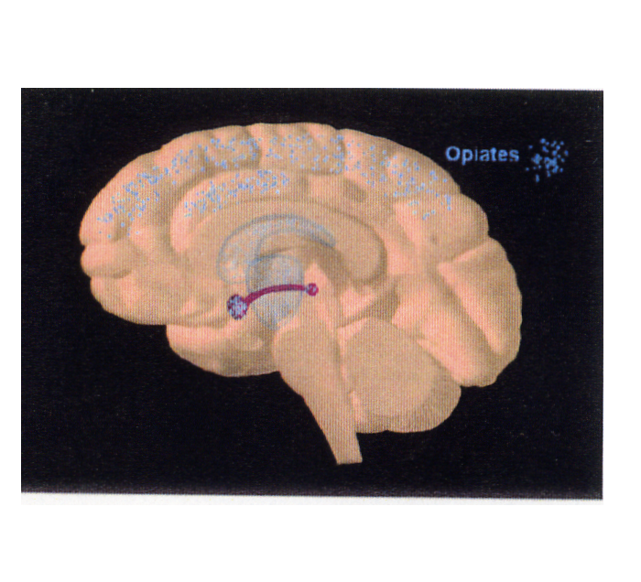

Slide 48
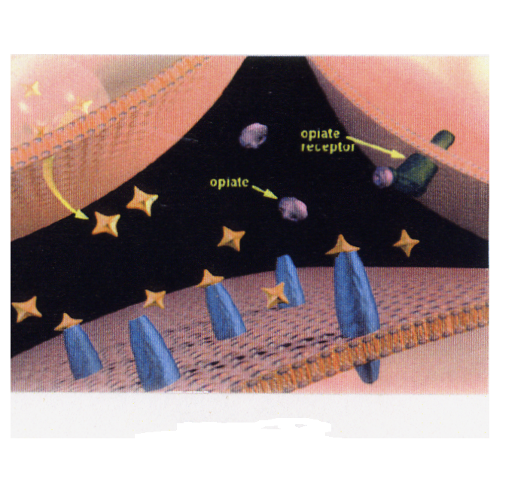

Slide 49
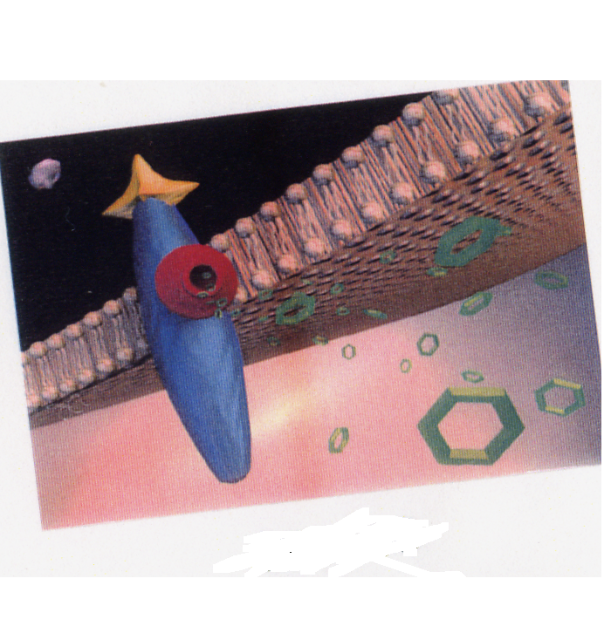

Slide 50
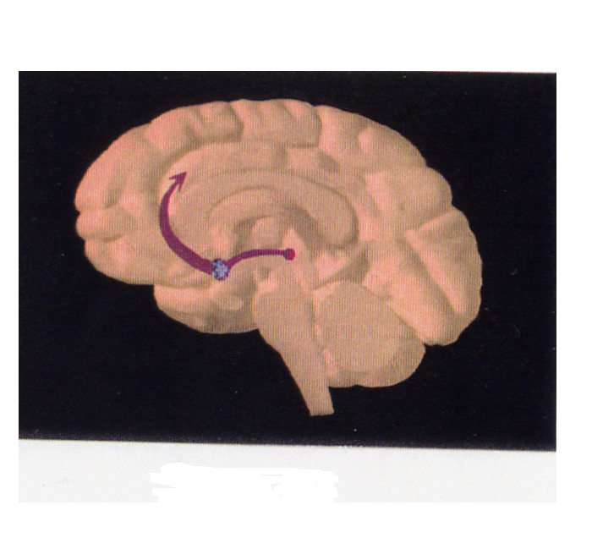

Slide 51
Medical aspects/3 questions
Craving/need relates to malfunction (long-term) in the reinforcement center
Loss of control relates to impaired pre-frontal cortex and “judgment”
Failure to learn from “bad stuff” happening relates to impaired circuitry of the above along with emotional/memory centers

Slide 52
Neurobiology
Neurotransmitters
Receptors
Second and third messengers
Nucleus/DNA/genes
Agonists
Antagonists
Partial agonists

Slide 53
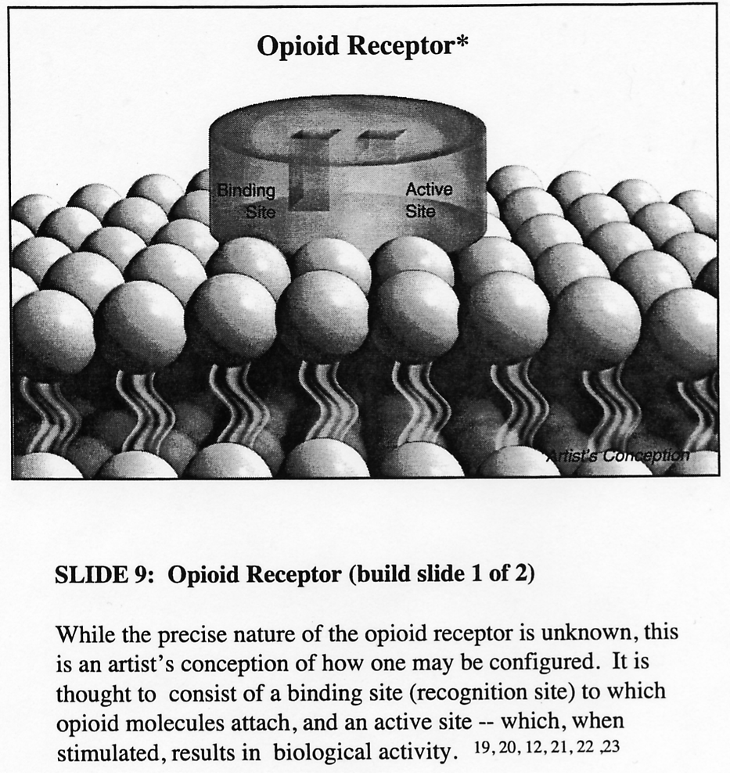

Slide 54
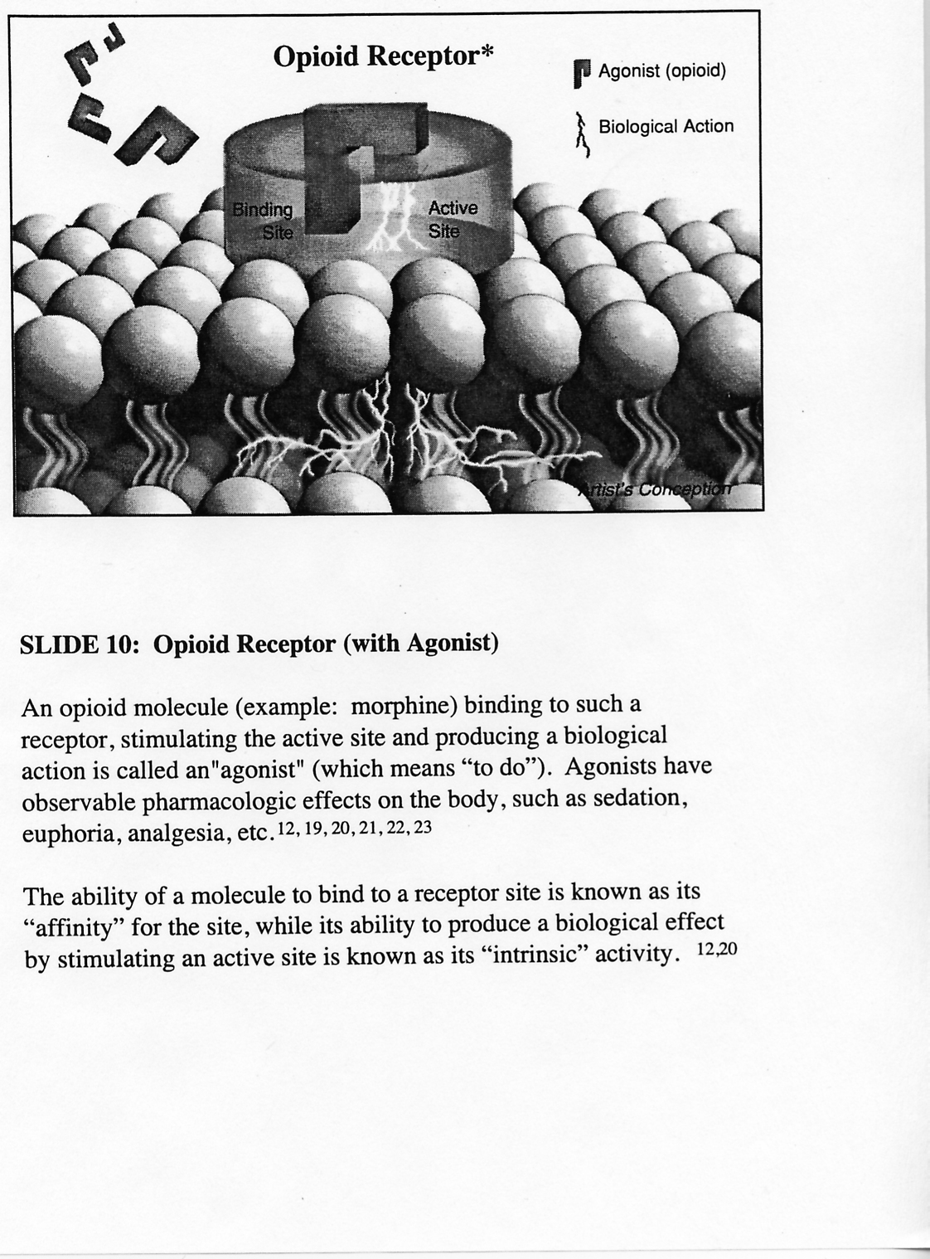

Slide 55
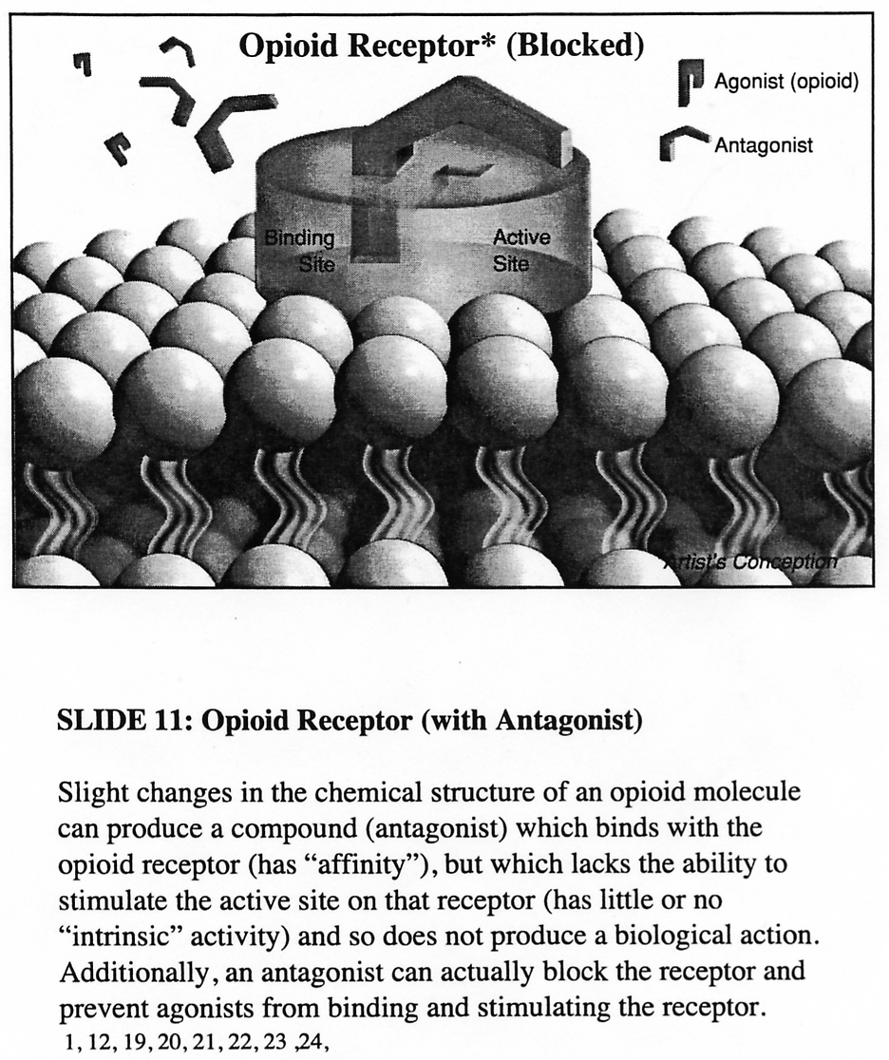

Slide 56
Neurobiology (cont)
Neuroadaption, tolerance, withdrawal: dopamine and the reinforcement center
Other chemicals modify dopamine response, e.g., opiates and all other addicting drugs

Slide 57
Neurobiology (cont)
Characteristics enhancing a chemical’s “addictiveness”
Full agonist
Short-acting/rapid onset
Amount of reinforcement induced
Role of affinity
Role of dissociation

Slide 58
Neurobiology (cont)
Characteristics decreasing a chemical’s “addictiveness”
Less agonism; antagonism
Longer-acting/slower onset
Route of administration: oral
Less intrinsic reinforcing activity

Slide 59
Choices in Dealing with Opioid Addiction
Withdrawal management, formerly referred to as “detoxification”
Short-term medication use
Long-term medication use
But always accompanied by “counseling”
There are 3 outcomes-based, research-supported, FDA-approved medications available

Slide 60
Withdrawal Management
Assume “good” counseling
Relapse rate for opioid addiction in 1 year: 95%
There is no such thing as an “addictionectomy”
Analogy: “Let’s get your diabetes controlled, and then send you home with diet and exercise only”

Slide 61
Short Term Medication
Assume “good” counseling
Relapse rate nearly as bad
But appears to be better than just withdrawal management
Analogy: “You can have your diabetes medication for awhile, but after that you shouldn’t need it anymore”

Slide 62
Long Term Medication
Assume “good” counseling
Lots of research (50years) to show good results
Good results = improved functioning as a person, as a family member, as an employee and as a member of society
Many studies consistently show societal expenses are reduced as well, ranging from $4 to 7 for each dollar spent on maintenance treatment

Slide 63
Medications for Opioid Addiction
Methadone
LAAM – no longer marketed
Buprenorphine=subutex and suboxone: partial opiate agonist +/- antagonist
Naltrexone
We’re decades behind in research compared with diabetes

Slide 64
Opioids - methadone
Synthesized in Germany in the 1940s
Claim to fame is its long duration of action, unlike other opioids, due to protein binding in tissues
Researched in 1960s by pharmacologist Vincent Dole and psychiatrist Marie Nyswander
Concept of methadone maintenance

Slide 65
Opioids - methadone
Mu receptor agonist
Large numbers of studies consistently show efficacy
It allows normalization of the hypothalamic-pituitary-adrenal axis
Heavily federally regulated when used for opiate dependence (vs. use for pain)

Slide 66
Why Opioid Maintenance? Theory Reality
Stable brain levels eliminate alternating euphoria and withdrawal that encourage continued use
Opiate-dependent patients rarely report euphoria after use, or craving at 24 hr.

Slide 67
Why Opioid Maintenance? Theory Reality
Hence, long-acting opioids are not reinforcing, reducing abuse potential
Patients’ “illicit” use of methadone/buprenorphine is primarily to “hold” them until they can get more short-acting opiates. Use of methadone or buprenorphine rarely meets DSM 5 substance use disorder criteria

Slide 68
Why Opioid Maintenance? Theory Reality
These stable levels appear to allow a “repair” or “return toward normal” of opioid receptor systems in the brain
Research confirms “improved” opioid systems, including, e.g., the hypothalamic-pituitary-adrenal axis, which affects stress response, immunity, and other systems

Slide 69
About dopamine levels
Standard dopamine levels:
On a good day – 50ng/dL
On a bad day – 40ng/dL
On best day – 100ng/dL
After an opioid detox 10-20ng/dL
Stable on MOUD 50-60ng/dL
Only 10% of individuals with low dopamine level are retained in treatment

Slide 70
Why Opioid Maintenance? Theory Reality
Given the foregoing, the phrase “just substituting one drug for another” completely fails to capture the idea
In fact, patients stabilized on maintenance medication “look” more like normal non-addicted individuals, both psychometrically and in their behaviors

Slide 71
Why All the Negative Press?
Continued social stigma attached to addiction, especially if you can’t “fix it yourself”
Continued stigma on the part of the treatment community---outcomes-based science has not yet replaced ideology
Opiate-addicted individuals stigmatize themselves, believing they are “guilty”

Slide 72
Negative Press (cont.)
Federal regulations previously did not promote adequate quality or quantity of programs; better under CSAT
Federal regulations operationalized as more of a barrier to, than a catalyst for, effective use of methadone
Consequently, consistency of treatment was poor in programs, which varied between “low-dose” and “methadone mills”

Slide 73
Things have changed
Progress in the science of opioid addiction now informs the more effective use of maintenance medications
Marked improvement in overall quality of methadone clinics, e.g.
Doses more individualized
More care with take-home medication
More counseling provided
The general public is relatively unaware of the improvement in treatment programs

Slide 74
Opioids - methadone
Can only be used in the treatment of opiate addiction by Opioid Treatment Programs – OTPs
OTPS require Federal licensing and are HIGHLY regulated in operation
An individual physician (who is not a licensed OTP) MAY NOT USE METHADONE for the purpose of treating addiction, be it withdrawal management or maintenance (exception: hospitalized pt)
But it CAN be used by individual physicians to treat pain

Slide 75
Opioids - methadone
Does it work
Yes, but –
Must be adequate dosing; metabolism is markedly individualized; blood levels are available
Must be sufficient length of treatment, often years
Must have counseling
Charleston Center’s results

Slide 76
Opioids – methadone
Best used for patients who:
Have high tolerance
Have more severe disease
May be using multiple other substances
Have higher psychiatric co-morbidity
Have failed other treatments
Have more “dysfunctional” lifestyle

Slide 77
Opioids - buprenorphine
Partial opiate agonist
Buprenorphine = Subutex
Buprenorphine + naloxone = Suboxone
Buprenorphine sublingually absorbed, naloxone not
But if broken down to use IV, the naloxone’s opioid blocking effect predominates, preventing intoxication and possibly precipitating acute withdrawal
Slow-release implant = Probuphine; lasts 6 months
Injectable slow-release = Sublocade; lasts 30 days

Slide 78
Opioids - buprenorphine
DATA 2000 (Drug Addiction Treatment Act)
Allows licensed physicians who undertake the required education to be “waivered”
Receive special “X” DEA number to allow use of buprenorphine for treating opiate addiction in office practice -- OBOT=office-based opiate treatment
Note: there is no such special training required for opioid prescribing for pain!

Slide 79
Opioids - buprenorphine
Suboxone use is opioid maintenance analogous to methadone maintenance
Schedule III medication
The idea is to bring drug treatment into the privacy of the primary care doctor’s office, de-stigmatizing opioid dependence, and getting people into treatment earlier in the course of their disease

Slide 80
Opioids - buprehorphine
Does it work
Yes, but –
Not all doctors (or their office staff) are skilled at dealing with the addicted population
Counseling still necessary, but availability is not always optimum
An individual doc can only treat 30 patients at a time for the first year, and no more than 100 at a time thereafter; up to 275 now, under certain circumstances

Slide 81
Opioids - buprenorphine
Best used for patients who:
Have less developed tolerance
Have less severe disease or are earlier in disease course
Are using no other substances, or using only minimally
Have less psychiatric co-morbidity
Have a more functional lifestyle, who have “lost less”
Are able to be more compliant with recommendations

Slide 82
Opioids - naltrexone
Naltrexone is a complete opiate antagonist
If taking naltrexone, the idea is to block all effects of any opioid administered, thereby preventing intoxication, hopefully ultimately extinguishing opioid drug-taking behavior
May reduce craving as well
May be given orally or by IM injection
Not a controlled substance, can be Rx’ed by any licensed physician

Slide 83
Opioids – naltrexone: oral
Does it work
Yes, but –
Compliance is an issue; one can just stop taking it
Probably works best with supervised/closely followed administration
Has been useful especially in professionals

Slide 84
Opioids – naltrexone: IM
Brand name Vivitrol, lasts 28 days through slow release
Does it work
Yes, but –
Very expensive (~$1,000/dose)
Must be off opiates for 5-14 days before it can be given
You can’t get any pain relief from opioids if you need it
Can be over-ridden under close medical supervision in an emergency

Slide 85
Opioids - naltrexone
Best used for patients who:
Have less severe disease
Do not need opioids for chronic pain
Refuse, for whatever reason, the use of agonist therapy
Have professional standing, and/or may be under close monitoring

Slide 86
Pregnancy Considerations
Misuse of short-acting opiate drugs is associated with complications: miscarriage, infections, premature delivery, low birth weight and others
Other factors influence outcomes: access to prenatal care, socioeconomic status, use of nicotine/alcohol/non-opiate drugs, and other factors

Slide 87
(Cont)
Relapse to opiate drugs after a detoxification (medically supervised withdrawal) is >90%
After decades of research, the standard of care is: maintenance medication through pregnancy
Measurable/treatable neonatal abstinence syndrome is preferable to “invisible” fetal abstinence syndrome
Can choose buprenorphine or methadone: equal efficacy

Slide 88
Pregnancy: Proper Dose
Individualized
Methadone dosing may need to be higher later in pregnancy due to increased volume of blood and tissue distribution
It’s not how many milligrams go down the throat, but rather what gets to the brain (and fetus) that matters
Patient report of effectiveness is generally reliable in adjusting dose

Slide 89
Medically Supervised Withdrawal During Pregnancy?
Not “officially” advised at this time due to risk of relapse
But patients may (1) refuse meds, (2) not tolerate meds, (3) have financial or geographic barriers to getting meds
Slow taper in second trimester is advised, avoiding increased chance of miscarriage in the first trimester and premature labor in the third; recent literature says first or third may be ok, but second trimester is still officially advised
Can use methadone or buprenorphine

Slide 90
Outcomes
Applies to methadone-maintained mothers, but probably applies to buprenorphine
May have slightly lower birthweight/head circumference than non-drug using, but still better than illicit opiate users
Neonates may be opioid-dependent, but they are NOT ADDICTED

Slide 91
NAS
Neonatal abstinence syndrome may occur, but frequently does not
Occurrence/severity not consistently correlated with maternal dose of med
Occurrence/severity may be improved when neonate stays in room with mother vs NICU placement
Treatment can prevent complications (medications used for tapering include morphine, methadone phenobarbital, clonidine)

Slide 92
Breastfeeding
Benefits outweigh any potential problems
Methadone shows minimally in breast milk, may ameliorate withdrawal symptoms somewhat, not shown to cause any developmental issues; same probably true of buprenorphine

Slide 93
Conclusion
Opiate dependent pregnant patients should be encouraged to use MAT, i.e., opioid maintenance treatment for the duration of pregnancy
However, tapering remains an option

Slide 94
Summary
Opioid use disorder (addiction) is a chronic brain disease like type 2 diabetes mellitus is a chronic disease of blood sugar regulation
It involves abnormal chemistry is some core brain areas and dysfunction in higher cortical centers
Counseling works on the cortical centers in the pre-frontal cortex (thinking and judgment)
Medications work on the core chemistry
Combined treatment (MAT) of opioid addiction is as successful as treatment of diabetes

Slide 95
Questions?

Slide 96
Opioid Use Disorder and MAT
John Emmel, MD
Medical Director, DAODAS and Charleston Center
jemmel@charlestoncounty.org

