Slide 1
What would it look like if we treated addiction like a public health problem?
Ed Johnson M.Ed., MAC, LPC, CCS
Associate Director, Southeast ATTC
edjohnson@msm.edu
www.attcnetwork.org/southeast

Slide 2
Learning objectives
What criteria must be met for a medical condition to be a “Disease”
Explore the “Acute Care” and “Chronic Care” models and how they relate to AOD Treatment
What is the “Public Health Model” and how it relates to AOD Prevention.
Discuss how our language reflects our concepts of AOD Treatment and Prevention.

Slide 3
Stigma
Stigma – A mark of disgrace or infamy associated with a particular circumstance, quality or person.

Slide 4
What is Addiction?
Is it willful misconduct
or
Is it a Medical Condition?

Slide 5
Choice Vs. disease
choice
disease
Free Will Exists
Responsibility
Can Stop
Punishment and Coercion do work
Behaviors can be controlled
No Free Will
No Responsibility
Can’t Stop
Punishment and Coercion don’t work
They have Symptoms

Slide 6
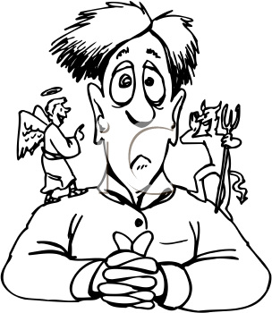
The Choice argument
Addiction can’t be a “Disease” because it’s a “Behavior”
An Addict can quit anytime, they just need the right motivation

Slide 7
So what are some of the “behaviors” that come to mind when you think of People with addiction?

Slide 8
Behaviors of folks with addiction
Lying
Cheating
Stealing
Manipulating
Irresponsibility
Denial
Selfishness
Lack of Caring

Slide 9
Causes of those behaviors
Sociopath
Criminality
Self-Centered
Character Defects
Addicted Personality
Demonic Possession
Gang Culture
Bad Parenting

Slide 10
Disease Theory
Organ
Defect
Symptoms

Slide 11
Organ
Defect
Symptoms
Pancreas
Islet Cells Death
Blurred Vision, Numbness, Coma
Femur
Fracture
Screaming, Bleeding, Deformity
?
Badness
See “Behaviors”

Slide 12
Behaviors of folks with addiction
Lying
Cheating
Stealing
Manipulating
Irresponsibility
Denial
Selfishness
Lack of Caring

Slide 13
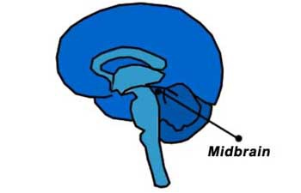
The MidBrain
The “Survival” part of the Brain
Focuses on Three things:
Eat
Kill (Defend)
Sex (Procreate)
Processing Center for all incoming information

Slide 14
Vulnerabilities for Addiction
Genetic
Developmental/Emotional
Psychiatric Co-Morbidity
Chronic Pain
Stress
Early Physical or Sexual Abuse
Witnessing Violence
Drug Used
Route of Administration
Dose
Frequency
Length of Use
Availability
Acceptability (peers who use)
Notes:
19
And these are some of the factors that lower the threshold for people to become addicted. The affect on brain chemistry can create more vulnerability. For example, scientists now know that prolonged stress, stress in our daily lives over long periods, can change our brain chemistry.
And think about the chemistry in the brain of an adolescent who starts using alcohol or drugs. Is it functioning normally, making decisions to use out of simple curiosity? Or, was there a lot of emotional distress, making the brain more vulnerable to the drug? These vulnerabilities can change over time. For example, older people may be more susceptible if they are suffering from depression or feeling isolated.

Slide 15
What pushes someone over the line is stress

Slide 16
Stress = severe
Face the same Severity of Stress
Face the same Pattern of Stress
Have the same functioning Coping Mechanisms
Come to the table with the Same Brain

Slide 17
Chronic stress
Chronic levels of Stress Hormones cause a defect in the Limbic System of the Brain (over production of dopamine). This defect affects the brains ability to properly perceive Pleasure
Notes:
Discuss “5 senses” and actually there are over 10, original 5 Hearing, vision, touch, smell, taste, liner acceleration, angular acceleration, Gravity (propioception), BloodpO2 & pCO2 and PLEASURE

Slide 18
What is “addiction”?
Addiction is a primary chronic disease of brain reward, motivation, memory and related circuitry. Dysfunction in these circuits leads to characteristic biological, psychological, social and spiritual manifestations. This is reflected in an individual pathologically pursuing reward and/or relief by substance use and other behavior.
Addiction is characterized by inability to consistently abstain, impairment in behavioral control, craving, diminished recognition of significant problems with one’s behaviors and interpersonal relationships and a dysfunctional emotional response. Like other chronic diseases, addiction often involves cycles of relapse and remission. Without treatment or engagement in recovery activities, addiction is progressive and can result in disability or premature death.
American Society of Addiction Medicine, 2011

Slide 19
Addiction Is………
A dysregulation of the midbrain dopamine (salience/ reward) system due to unmanaged stress resulting in symptoms of decreased functioning.
Specifically:
Loss of control
Craving
Persistent drug use despite negative consequences

Slide 20
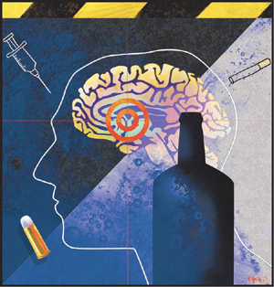
Medical condition
Affects specific organs or parts of the body
Has identifiable causes
Has identifiable signs and symptoms
Is either acute or chronic

Slide 21
Acute vs. Chronic
A “Chronic” Condition has:
Gradual onset
Lifetime course
May have “acute” episodes
Multi-modal Treatments
Variable response rates depending on patient, treatment and outside factors
An “Acute” Condition has:
Rapid onset
Short course
May be severe

Slide 22
The Acute Care Model
Encapsulated set of service activities (assess, admit, treat, discharge, termination of service relationship).
Professional expert drives the process.
Services transpire over a short (and ever-shorter) period of time.
Individual/family/community is given impression at discharge (“graduation”) that recovery is now self-sustainable without ongoing professional assistance.

Slide 23
The Chronic Care Model
Initial triage and stabilization, support services are varied and open ended most concentrated early on.
Professionals serve as consultants. Goal is for course of treatment to be patient driven to achieve highest level of adherence.
Services are open ended, routine follow-up the norm.
Individual/family/community educated on the “process” nature of “treatment”. Goal is to facilitate improved quality of life and wellness for the patient in whatever way works best for the patient.

Slide 24
Types of Chronic Diseases
Hypertension
Diabetes
Asthma
Addiction

Slide 25
Chronic Disease Comparison
Diabetes
Addiction
Genetic predisposition
Lifestyle choices are a factor in development of the disease
Severity is variable
There are diagnostic criteria
Once diagnosed, you’ve got it
Genetic predisposition
Lifestyle choices are a factor in development of the disease
Severity is variable
There are diagnostic criteria
Once diagnosed, you’ve got it

Slide 26
Chronic Disease Comparison
Diabetes
Addiction
Primary treatment is lifestyle modification
Small percentage of patients comply with same
Medications can help
Treatment planning starts where the patient is and is based on patient strengths.
Primary treatment is lifestyle modification
Small percentage of patients comply with same
Medications can help
Treatment starts based on clinician problem assessment and is pathology focused.

Slide 27
Chronic Disease Comparison
Diabetes
Addiction
Patients often don’t comply with medical regimen
Treatment is not withdrawn if patient becomes symptomatic
Patients often don’t comply with medical regimen
Patients are discharged from treatment for non-compliance
“Frequent Flyers” are denied access to services

Slide 28
Chronic Disease Comparison
Diabetes
Addiction
Patients who are partially compliant are the rule, and outcomes are better than those who do not get treatment
Treatment is ongoing with routine follow-up.
Multi-disciplinary team is involved in treatment.
Support systems improve outcomes
Patients who are partially compliant are the rule, and outcomes are better than those who do not get treatment
Treatment is episodic with no follow-up
Treatment involves only AOD Professionals
Support systems improve outcomes

Slide 29
Chronic Disease Comparison
Diabetes
Addiction
Even in highly motivated patients, only a small percentage will succeed without medication. “Abstinence” from medication is lowest priority
Incremental progress is accepted, goal is improved “wellness”.
Abstinence is still often the underlying goal, without which treatment (and the patient) is judged a failure???
Incremental progress is not viewed positively. “Wellness” is only viewed through the lens of total abstinence.

Slide 30
Disease Comparison: Conclusion
Chronic disease may be controllable, but not usually curable
Medications, if available, are useful to promote this “disease control”
Focus is on meeting patient where they are, building on their strengths, moving toward increased wellness
There is a “disconnect” between treatment of addiction vs. other chronic diseases

Slide 31
Reoccurrence Rates Are Similar for Addiction and Other Chronic Illnesses
100
90
50 to 70%
50 to 70%
80
40 to 60%
70
30 to 50%
60
Percent of Patients Who Relapse
50
40
30
20
10
0
Drug
Dependence
Type I
Diabetes
Hypertension
Asthma
Source: McLellan, A.T. et al., JAMA, Vol 284(13), October 4, 2000.
Notes:
The good news is that people in recovery do very well after treatment, in fact better than people with other kinds of chronic diseases. A study was published in the Journal of the American Medical Association showing that relapse rates for people who really need to manage their recovery on a daily basis. As you can see, people in recovery from addiction do better than people with hypertension, asthma and just about as well as people with diabetes.

Slide 32

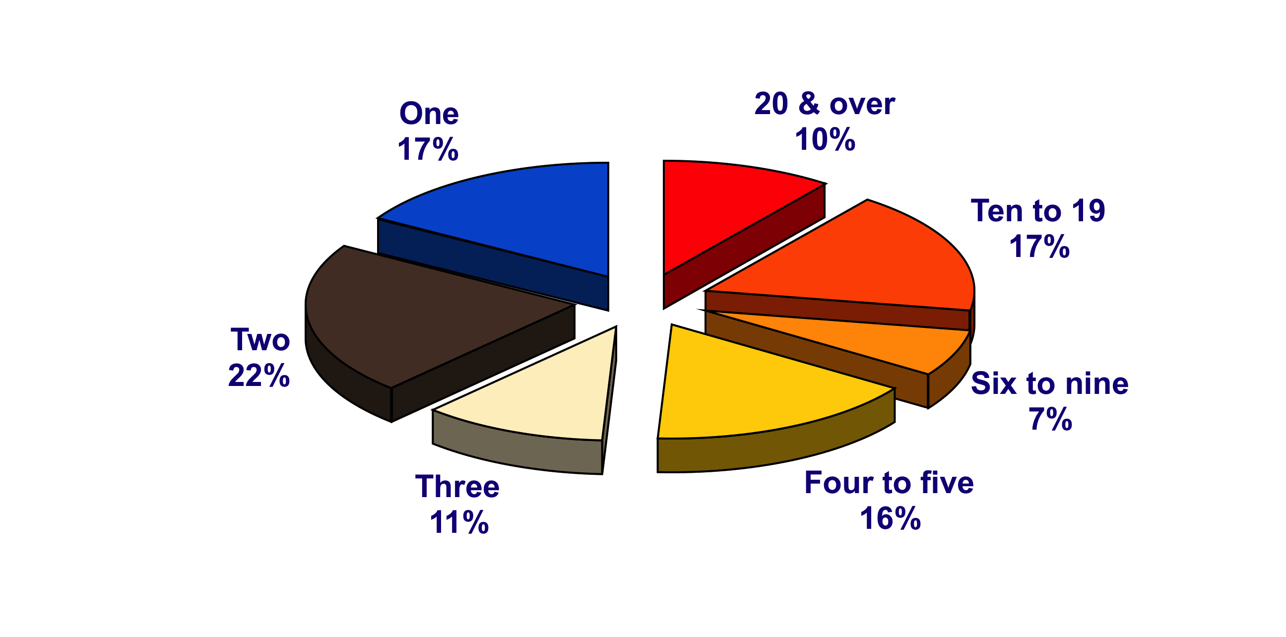
Addiction “Career”
Number of abstinent periods one month or longer followed by return to drug use prior to current abstinence*
50% reported 4
or more
abstinent periods
followed by a return to active addiction
*Outside of controlled environment, among those who report one or more such periods: 71% N=248 Laudet & White 2004
Notes:
To highlight this point, a study conducted by Dr. Alexandre Laudet and William White (involving 246 individuals) in which 50% of participants reported having four or more abstinent periods followed by a return to active addiction. This is likely very consistent with the experience that many of you see everyday.
(Discussion Point: You may choose to leave this statement in or you may want to ask the audience what their experience is as far as their own experience as counselors)
Reference:
Laudet, A. & White, W. (2004). An exploration of relapse patterns among former poly-substance users. Presented at the 132nd Annual Meeting of the Amer. Public Health Association, Washington DC.

Slide 33
SAMHSA Definition of Recovery
Recovery from Mental and Substance Use Disorders is a process of change through which individuals work to improve their own health and well-being, live a self – directed life and strive to achieve their full potential

Slide 34
Guiding Principles of Recovery
Recovery is person-driven
Recovery occurs via many pathways
Recovery is holistic
Recovery is supported by peers and allies
Recovery is supported through relationships and social networks
Recovery is culturally based and influenced
Recovery is supported by addressing trauma
Recovery involves individual, family and community strengths and responsibilities
Recovery is based on respect
Recovery emerges from hope

Slide 35
Recovery Capital
Recovery Capital (RC) is the quality and quantity of internal and external resources that one can bring to bear on the initiation and maintenance of recovery from a life-disordering condition.
Typically, the higher one’s recovery capital, the likelihood of sustained recovery increases.
Notes:
Recovery capital is the breadth and depth of internal and external resources that can be drawn upon to initiate and sustain recovery from severe alcohol and other drug problems (Cloud & Granfield, 2004). Recovery capital is conceptually linked to natural recovery, solution-focused therapy, strengths-based case management, recovery management, resilience and protective factors, and the ideas of hardiness, wellness, and global health.
There are three types of recovery capital that can be influenced by addictions professionals: Personal, Family/Social and Community (White & Cloud, 2008).
Reference:
Cloud, W., & Granfield, R. (2004). A life course perspective on exiting addiction: The relevance of recovery capital in treatment. NAD Publication (Nordic Council for Alcohol and Drug Research) 44, 185-202.
White, W. & Cloud, W. (2008). Recovery capital: A primer for addictions professionals. Counselor, 9(5), 22-27.

Slide 36
Personal Recovery Capital
Physical recovery capital includes:
physical health
financial assets
health insurance
safe and recovery-conducive shelter
clothing, food, and
access to transportation.
White and Cloud, 2008
Notes:
Reference:
White, W. & Cloud, W. (2008). Recovery capital: A primer for addictions professionals. Counselor, 9(5), 22-27.

Slide 37
Personal Recovery Capital
Human recovery capital includes:
values
knowledge
educational/vocational skills and credentials
problem solving capacities
self-awareness, self-esteem, self-efficacy
hopefulness/optimism
perception of one’s past/present/future
sense of meaning and purpose in life, and
interpersonal skills
White and Cloud, 2008
Notes:
Reference:
White, W. & Cloud, W. (2008). Recovery capital: A primer for addictions professionals. Counselor, 9(5), 22-27.

Slide 38
What would “treatment” look like if we focused on “recovery”?

Slide 39
8 Key Performance Arenas Linked to Long-term Recovery Outcomes
1. Attraction, access & early engagement
2. Screening, assessment & placement
3. Composition of the service team
4. Service relationship
5. Service dose, scope & quality
6. Locus of Service Delivery
7. Assertive linkage to communities of recovery
8.Post-treatment monitoring, support and early re-intervention

Slide 40
1. Attraction, Access & Early Engagement
Recovery Management Directions
Assertive community education & outreach
Assertive waiting list management
Lowered threshold of engagement; rethinking motivation; institutional outreach
Changes in administrative discharge policies

Slide 41
2. Screening, Assessment & Placement
Recovery Management assessment is global, strengths-based, client focused (rapid transition to recovery plans), continual and encompasses the individual, family and recovery environment; recovery capital factored into placement decisions.

Slide 42
3. Composition of the Service Team
Recovery Management expands role of medical (including primary care physicians) and other allied professionals, recovering people (P-BRSS) and culturally indigenous healers. Also emphasizes reinvestment in volunteer and alumni programs.

Slide 43
4. Service Relationship
Recovery Management: Sustained recovery partnership (long-term consultation) model; emphasis on prolonged continuity of contact; client as co-leader; philosophy of choice; greater use of personal/professional self; contrasting ethical guidelines.

Slide 44
5. Service Dose, Scope & Quality
Recovery Management model emphasis on importance of dose (NIDA principles—90 days), role of ancillary services and weeding out practices that are not linked to recovery outcomes or that may produce inadvertent injury.

Slide 45
6. Locus of Service Delivery
Recovery Management model emphasizes the ecology of long-term recovery: “How do we nest recovery in the natural environment of this individual or create an alternative recovery-conducive environment?”
* Healing forest metaphor (Coyhis)
* Concept of “community recovery”

Slide 46
7. Assertive Linkage to Communities of Recovery
Recovery Management Model: Assertive linkage, multiple pathway model of recovery, linkage beyond recovery mutual aid groups; active relationship with local service committees, involved in recovery community resource development

Slide 47
8. Recovery Management Model: Assertive Approaches to Continuing Care
Post-treatment monitoring & support (recovery checkups)
Stage-appropriate recovery education & coaching
Assertive/continued linkage to recovery resources
Early re-intervention & re-linkage to Treatment and recovery support resources
Recovery community building

Slide 48
8. Post-treatment Monitoring, Support and, if needed, Early Re-intervention
25-35% of clients who complete addiction treatment will be re-admitted to treatment within one year, 50% within 2-5 years (Hubbard, et al, 1989; Simpson, et al, 2002).
An Acute Revolving Door: Of those admitted to the U.S. public treatment system in 2003, 64% were re-entering treatment--23% accessing treatment the 2nd time, 22% for the 3rd or 4th, and 19% for 5 or more times (OAS/SAMHSA, 2005).

Slide 49
8. Post-treatment Monitoring, Support and, if needed, Early Re-intervention
50-80-90 rule: More than 50% of clients discharged from Tx will return to some use in the next year—80% of those will do so in first 90 days after discharge.
15-25 rule: The stability point of recovery (risk of future lifetime relapse drops below 15%) isn’t reached until 4-5 years for alcohol dependence; 25% of opioid dependent persons who achieve five years of abstinence will later resume narcotic addiction.

Slide 50
8. Acute Care Model: “Aftercare” as an Afterthought
Post-discharge continuing care can enhance recovery outcomes (Johnson & Herringer, 1993; Godley, et al, 2001; Dennis, et al, 2003).
But only 1 in 5 (McKay, 2001) to 1 in 10 (OAS, SAMHSA, 2005) adult clients receive such care (McKay, 2001) and only 36% of adolescents receive any continuing care (Godley,et al, 2001)

Slide 51
Shame & stigma

Slide 52
Watch your thoughts,
they become words
Watch your words,
they become actions,
Watch your actions,
they become habits
Watch your habits,
they become character
Watch your character,
it becomes your destiny
Anon.

Slide 53
Words and phrases to Think About
Relapse
Denial
Clean / Sober
Drug of Choice
Relapse is part of Recovery
Abstinence
A Drug is a Drug is a Drug
Self Help Groups
Consumer / Patient / Client
Substance Abuse
Not Ready Yet, Doesn’t Want it Bad Enough
Retreads /Frequent Flyers / Chronic Relapser
Addressing Folks
“Person First” Language

Slide 54
If you have some respect for people as they are, you can be more effective in helping them to become better than they are
John W. Gardner

Slide 55
So what about prevention?

Slide 56
Two “Models”
Crime Control Model
Punishment and Moralizing with the “offender”
Public Health / Disease Control / Harm Reduction Model

Slide 57
The public health model
“Public Health” – Is the art and science of preventing disease, prolonging life and promoting health through the organized efforts and informed choices of society, organizations, public and private communities and individuals

Slide 58
The “Model”
Define the Problem
Identify Risk and Protective Factors
Develop and Test Prevention Strategies
Assure Widespread Adoption

Slide 59
Defining the “problem”
The “Big Three”
Agent
Host
Environment
The Goal
Reduce harm and negative impact on the individual and the community

Slide 60
The “Model” with Breast Cancer
Define the Problem
Identify Risk and Protective Factors
Develop and Test Prevention Strategies
Assure Widespread Adoption

Slide 61
The “Model” with tobacco
Define the Problem
Identify Risk and Protective Factors
Develop and Test Prevention Strategies
Assure Widespread Adoption

Slide 62
So what would the “model” look like with Addiction?
Define the Problem
Identify Risk and Protective Factors
Develop and Test Prevention Strategies
Assure Widespread Adoption

Slide 63
The “big Three” with Addiction
The “Big Three”
Agent – The individual
Host – The Psychoactive Substance
Environment – The availability and accessibility of the substance; community attitudes
The Goal
Reduce harm and negative impact on the individual and the community

Slide 64
I’ve learned that people
Will forget what you
said, people will forget
what you did but people
will never forget how
you made them feel.
Maya Angelou

